Slide 1
DSPG 2019
Midterm Updates

Slide 2
Time set. | Project​ | a.k.a​ | Sponsor/Contact(s)​ | SDAD Team​ | DSPG​ Fellow(s) | DSPG Intern(s)
9:30 | Credential-to-Skilled Technical Workforce (STW) Pathways in Virginia​ | STW | John Finamore, National Center for Science and Engineering Statistics (NCSES)​ | Vicki​ | ​Alyssa | Sarah Calvin
9:45 | Defining and Measuring the Universe of Open Source Software​ Innovation​ | OSS​ | Carol Robbins, NCSES​ | Gizem​ Bayoán​ | Cong | Eliza Calvin
10:00 | Machine Learning Techniques to Measure Business Innovation ​ | Business Innovation​ | Gary Anderson, NCSES​ | Devika​ Gizem​ Neil | Quinton | Raghav
10:15 | Measuring the Public Funding of R&D Projects​ | R&D Metrics​ | John Jankowski, NCSES​ | Stephanie Joel​ | ​Alyssa | Sean
10:30 | Validation of Broadband Data and Identification of Factors that Predict Property Values ​ | USDA Broadband​ | John Pender, USDA Economic Research Service (ERS)​ | Josh​ Teja​ Stephanie​ | Kat | Sarah Raghav
BREAK
11:00 | Building a Fairfax County CommunityScape to Understand Social Determinants of Health and Prosperity​ | Fairfax & INOVA​ | Fairfax County Health and Human Services,​ & Inova Translational Medicine Institute​ ​ | Teja​ Joy​ Stephanie​ Vicki​ Josh​ | Cong Quinton | Eliza Victoria
11:15 | Discovering the Potential and Use of New Data Sources to Measure the Soldier’s Social Determinants of Health​ | ARI​ | Army Research Institute (ARI)​ | Stephanie​ Josh​ Nathaniel Joel Vicki | Allegra | Jessica Sean
11:30 | Economic and Social Impact of Arlington Restaurant Initiative​ | ACPD​ | Jim Mastoras​ Arlington County Police Department (ACPD)​ | Bayoán Gizem​ Aaron​ | ​Kat | Victoria
11:45 | Returning Citizens Reentry Program​ ​ | Criminal Justice​ | Gregory Fairchild, Darden; UVA​ & Virginia Department of Corrections (VADOC)​ | Nathaniel Joel​ Bayoán​​ Aaron​​ | Allegra | Jessica

Slide 3
Skilled Technical Workforce Pathways
Data Science for the Public Good, Summer 2019
Vicki Lancaster, Ph.D., Alyssa Fowers, Sarah McDonald, and Calvin Isch

Slide 4
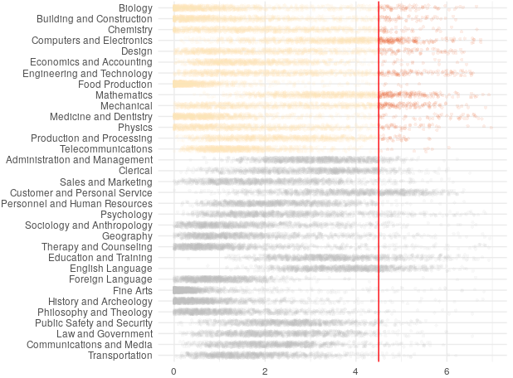
What Is Skilled Technical Work?
Positions that require a high level of technical knowledge, but do not require a bachelor’s degree
Pathway to the middle class without requiring college education
Critical to success of American economy and industry
Fewer than 20% of occupations require a high level of technical knowledge
High Level of Knowledge
Technical knowledge
Types of Knowledge
Non-technical knowledge
Source: O*NET survey
Rating of knowledge required for each occupation

Slide 5
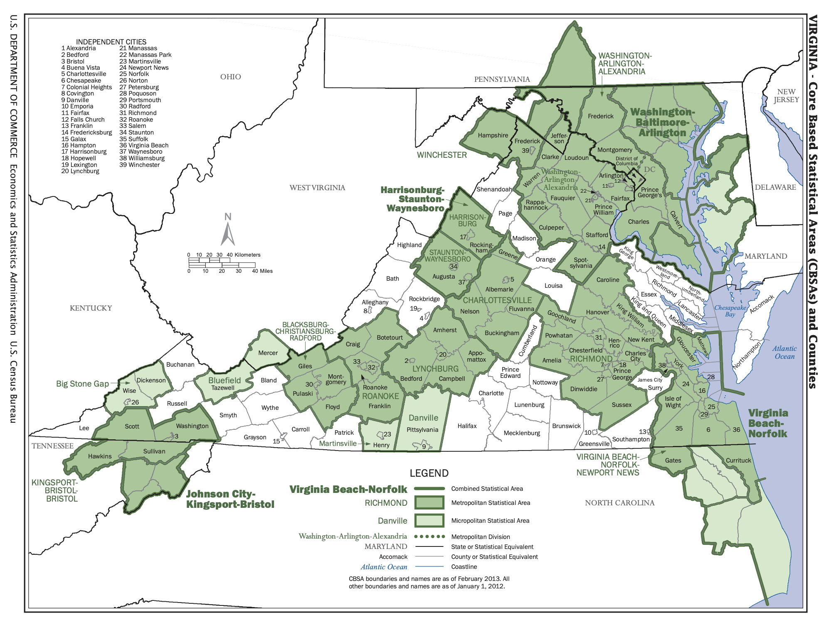
Focus on Richmond and Blacksburg
Examining two metropolitan statistical areas in 2017:
Richmond and Blacksburg
Completely contained within Virginia
“Quarantined” from each other by distance

Slide 6
Research Questions
For individuals with an Associate’s degree or less in Virginia, what are the pathways to non-degree credentials that will provide them with the skills necessary to secure a job in the skilled technical workforce (STW)?
Can we develop a metric that will identify the weak points in the pathway that can be useful for job seekers, policy makers, and educators?
Can this proof of concept be extended to other states?

Slide 7
What skilled technical positions are available? What skills are required for those jobs?
Where can residents train for skilled technical positions?
What skills do local workers already have?
Local Job Market
Current Workforce
Educational Opportunities
Do the skills required by the job market match the skills of the local workforce?
Do local educational opportunities prepare workers for in-demand local jobs?

Slide 8
Describing the Local Job Market With Online Job Ads
What skilled technical positions are available? What skills are required for those jobs?
Local Job Market
Current Workforce
Educational Opportunities

Slide 9

Burning Glass Technologies* (BGT) delivers job market analytics that empowers employers, workers, and educators to make labor market data-driven decisions.¹
50,000
sites daily
70
variables
2007-19
*!(08 & 09)
* https://www.burning-glass.com/about/

Slide 10
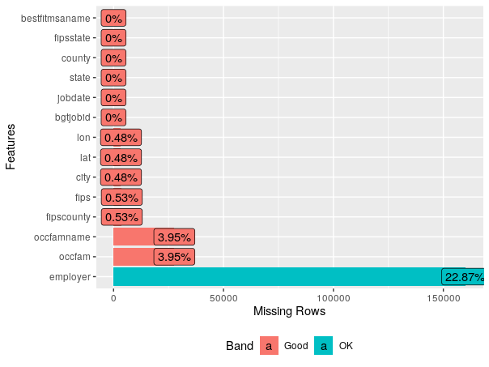
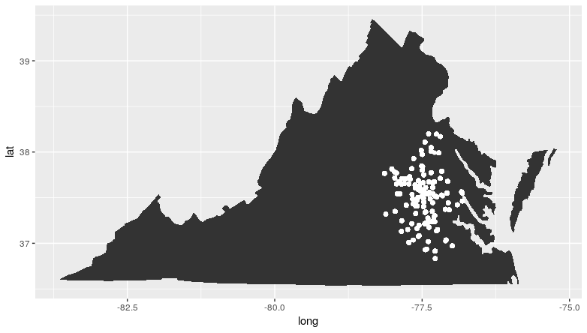
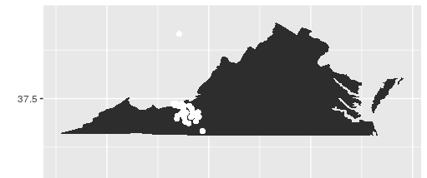
Job Ad Data Description
Job-ad Data
5 data files: main, skills, major, classification of instructional program codes, & certifications
699,754 unique job postings in Virginia in 2017
Example of Data Profiling for Completeness
99,997 unique postings for Richmond MSA
11,232 unique postings for Blacksburg MSA

Slide 11
Describing the Current Workforce with Online Resumes
What skilled technical positions are available? What skills are required for those jobs?
What skills do local workers already have?
Local Job Market
Current Workforce
Educational Opportunities

Slide 12
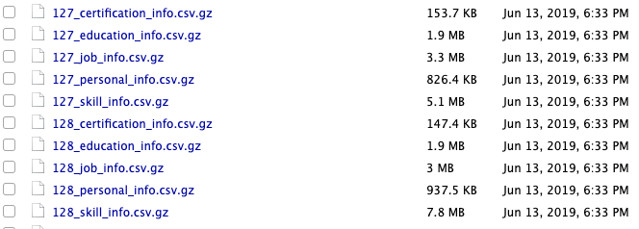
Resume Data Description
The resume dataset is a BGT proprietary dataset, sourced from Burning Glass partners.
demographics, career path, education, certifications, skills, and employers.
Untested in the literature except for Burning Glass (BGT)
Use BGT technique, to track career pathways for MSAs
2,200 files
Hard to link—not impossible

Slide 13
Connecting Ads to Resumes With Burning Glass Skills Data
Local Job Market
Current Workforce
Educational Opportunities
Do the skills required by the job market match the skills of the local workforce?

Slide 14
Investigating Local Educational Opportunities
Where can residents train for skilled technical positions?
Local Job Market
Current Workforce
Educational Opportunities

Slide 15
Investigating Local Educational Opportunities
Apprenticeships
Certificate programs
Traditional Education
Associate's degrees
Local Job Market
Current Workforce
Educational Opportunities
Non-Traditional Education
Non-Traditional Education
Coding bootcamps
Massively open online courses
Certifications

Slide 16
Education Data - Providers of Traditional Credentials
State Council of Higher Education for Virginia (SCHEV)
Colleges and Universities
Department of Labor and Industry (Virginia DOLI)
Apprenticeships
Virginia Department of Education (VDOE)
High School Career and Technical Schools
Virginia Community Colleges System (VCCS)
Credentials

Slide 17
Investigating Local Educational Opportunities
Apprenticeships
Certificate programs
Traditional Education
Associate's degrees
Local Job Market
Current Workforce
Educational Opportunities
Massively open online courses
Non-Traditional Education
Coding bootcamps
Certifications
Non-Traditional Education
Coding bootcamps
Massively open online courses
Certifications

Slide 18

Education Data - Providers of Alternative Credentials
CareerOneStop
Certification
Licenses
Professional Associations
Apprenticeship
Challenge: Connecting provider list to students in our MSAs

Slide 19

Education Data - Providers of Alternative Credentials
Credential Engine Registry
Apprenticeship Certificate
Associate Degree
Bachelor Degree
Badge
Certificate
Degree
Digital Badge
Diploma
Doctoral Degree
General Education Development
Journeyman Certificate
Licenses
Master Certificate
Master Degree
MicroCredential
OpenBadge
Professional Doctorate
Quality Assurance Credential
Research Doctorate
Secondary School Diploma
Challenge: Connecting provider lists to students in our MSAs

Slide 20



Education Data - Providers of Alternative Credentials
Class Central
Massive Online Open Courses (MOOCs)
Course Report & Switchup
Coding Bootcamps
Challenge: Connecting provider lists to students in our MSAs

Slide 21
Connections and Mismatch
Apprenticeships
Certificate programs
Traditional Education
Associate's degrees
Local Job Market
Current Workforce
Educational Opportunities
Massively open online courses
Non-Traditional Education
Do the skills required by the job market match the skills of the local workforce?
Coding bootcamps
Certifications
Do local educational opportunities prepare workers for in-demand local jobs?

Slide 22
Measuring Mismatch
Measuring Mismatch
Mismatch metric from Berkes, Mohnen, and Taska (2018):
Employer's perspective: are there enough workers with the right skills to fill open jobs?
Job-seeker's perspective: are there enough jobs that match skillset of local workers?
Education: Mutual Information Index to get linkage strength between careers and educational paths, compare to local educational opportunities

Slide 23
Ethics
Ethics and Biases in the Data
Some non-traditional providers guarantee a job after program completion, so the BGT resume data may not be comprehensive
The BGT job data may be skewed toward jobs requiring higher levels of education
The education data will not be comprehensive of every non-traditional education route
The project, for now, only focuses on two MSAs

Slide 24
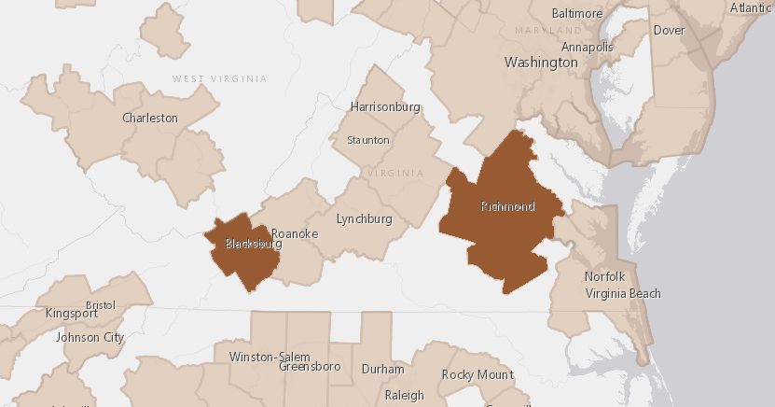
Progress and Plans
Progress and Next Steps
Data discovery
Data profiling
Construction of metric to capture mismatch
Determine best definition of STW
Exploratory data analysis
Analysis of pathways to STW credentials and mismatch in Virginia

Slide 25

Machine Learning Techniques to Measure Business Innovation
SDAD Team: Devika Nair, Gizem Korkmaz, Neil Alexander
DSPG Team: Quinton Neville and Raghav Sawhney
Sponsor: Gary Anderson, National Science Foundation (NSF) National Center for Science and Engineering Statistics (NCSES)
Notes:
1) Raghav introduction
2) Quinton introduction
3) NSF sponsorship – MC is Gary Anderson

Slide 26

Background
National Center for Science & Engineering Statistics
Business R&D and Innovation Survey
Yearly
Self-reported
How many?
When?
Level?
Notes:
Every year the NSF – NCSES conducts the BRDIS survey which reaches out to businesses in a variety of locales and sectors to ask, among other things, whether or not the business made an innovation in the last year. Outside of just monetary value, this is an important question because innovation reflects a multitude of important economic indicators which are of paramount interest to the NCSES. However, as with any survey, the BRDIS inherently comes with certain limitations regarding the information or data which it collects. Specifically, as a yearly cross sectional survey, the question of whether or not a company produced an innovation in last year lacks a specific temporal component (I.e. when did the innovation occur?), how many innovations the company produced in that year (one or many?), and how impactful or to what degree the innovation had an affect on the market/consumers (none, low, high?). Consequently, we've been tasked with pursuing alternative methods to detect, classify, and evaluate innovation to supplement this yearly survey and provide valuable information to the NCSES.

Slide 27

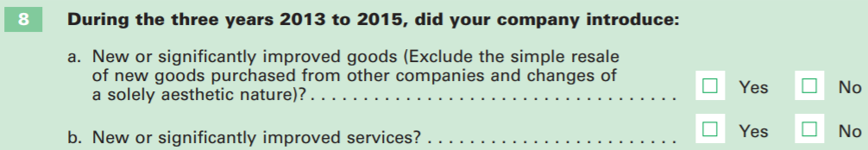
What is innovation?
OSLO Manual - "A new product, or an improvement made to an existing product, which produces a significant impact or change to the market/consumers"
Types of Innovation
- Process
- Product
BRDIS
Notes:
What is it? - The gold standard for defining and measuring Innovation comes from the Oslo manual, a rulebook put out by the Organization for Economic Co-operation and Development, most recently updated in 2018. For our purposes, we utilize this manual to define an Innovation as "A new product, or an improvement made to an existing product, which produces a significant impact or change to the market/consumers" (?). In this case, we are taking an object oriented retrospective approach, only considering products which have physically made it to market.
Why is it important? - Measuring innovation is an important indicator of the economic health of a country, how fast its growing and how competitive it is on a global scale. Consequently, finding alternative data sources to predict and classify innovations can provide new, valuable information to supplement the existing BRDIS survey and provide a new framework for thinking about innovation.
Considering both the what and the why of our endeavor, we chose to initialize our study within the scope of the Food and Drug Administration, more specifically, the Pharmaceutical industry. We did those for 3 primary reasons.
1. It is highly regulated – which reduces extraneous noise and provides a solid platform to build our predictive algorithms
2. It is new – by which I mean the Pharma industry is constantly churning out new and improved products
3. It is relevant – because its highly scrutinized, especially more recently, it appears frequently in the news ….. (which leads directly to the next slide, Dow Jones DNA data)
#Split these into two slides 1) Innovation, 2) Focus on FDA

Slide 28


Our Focus
Product innovation
Easier to capture with public data
Pharmaceutical sector
Highly regulated
Publicly available
Frequency
Food and Drug Administration
Focus
Notes:
Considering both the what and the why of our endeavor, we chose to initialize our study within the scope of the Food and Drug Administration, more specifically, the Pharmaceutical industry. We did those for 3 primary reasons.
1. It is highly regulated – which reduces extraneous noise and provides a solid platform to build our predictive algorithms
2. It is publically – by which I mean the Pharma industry is constantly churning out new and improved products
3. It is relevant – because its highly scrutinized, especially more recently, it appears frequently in the news ….. (which leads directly to the next slide, Dow Jones DNA data)
Examples of innovation and one that's not

Slide 29


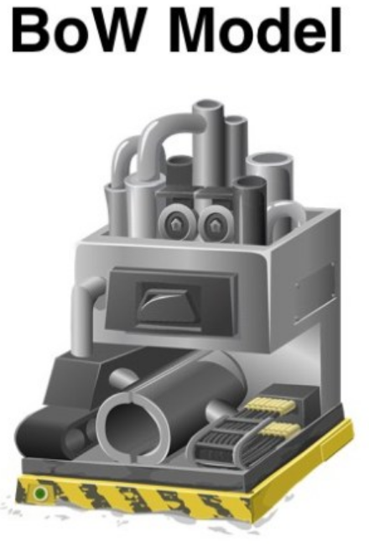

Project Flow
1. Data Discovery
2. Exploration &
Manipulation
3. Labeling
Text Analysis
Machine Learning
Classification
https://www.tidyverse.org
4. Prediction
Notes:
Notes --
Checkmark at discovery
Switch 2. 3.

Slide 30


2 Million Articles
10 Gigabytes
Semi-structured Data
New software
Notes:
After vetting a variety of sources for predicting innovation (and conducting an extensive literature review,?) we decided to pursue the Dow Jones Data News and Analytics (DNA) database (formerly Factiva for those familiar) as our primary data source (for this part of the larger project?). This resource provides a detailed catalog of academic, journal, and news publications. Recalling that we are focused on Innovations In the Pharmaceutical Industry specifically, we pulled 2 million news articles (ignoring academic and journal publications for this particular industry ?) that pertain to this industry, in the United States, from 2010 – 2018 (?) , that were flagged for some manner of innovation using their heuristic.
The data, coming in the form of moderately structured text files with intelligent (though not necessarily transparent/accurate) tags, is incredibly large in size. 2 million articles take up about 10 Gb of space on your computer, which for reference is more than the original Iphone could hold 10 years ago. Just simply transforming these data into a format able to be read into a fully structured format for analysis was an arduous task, and the software we typically use to perform analysis/modeling R, is not very well equipped to handle this particular size and type of data. Consequently we are transitioning into using Python, another open source language, for its versatility and speed.
1. 2 million
2. 10 gb
3. years
4. python

Slide 31
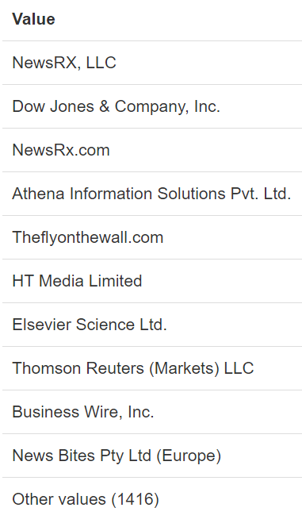
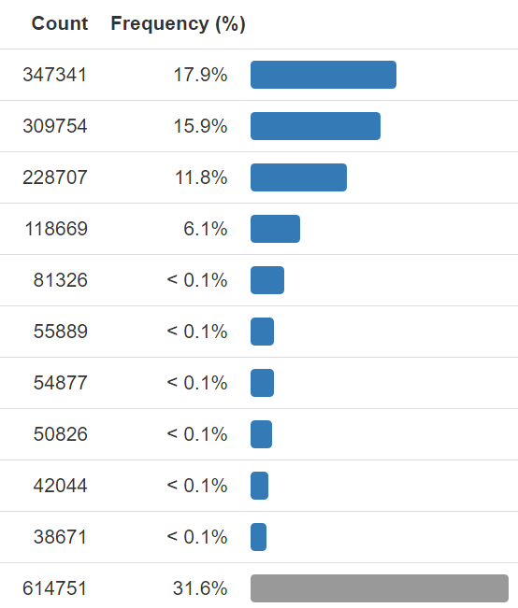
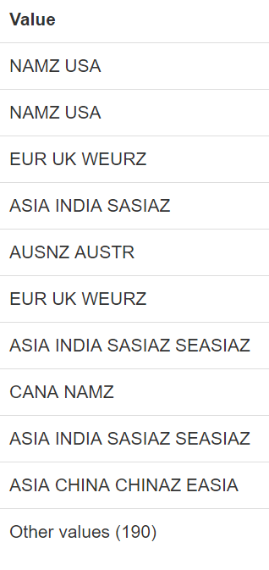
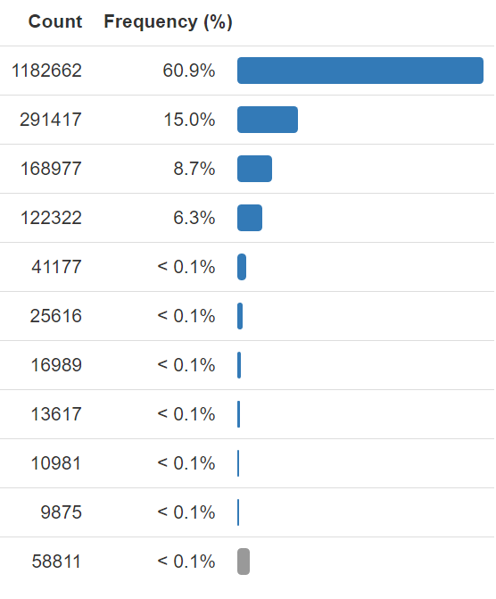
Data Overview
Article Publisher
Article Region of Origin
Notes:
We have two NAMZ USA. We should try and include just one by joining the two NAMZ values

Slide 32
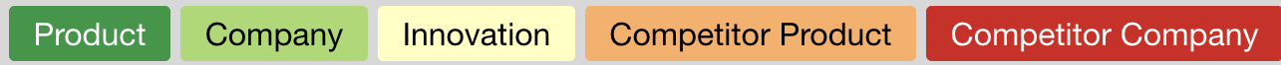
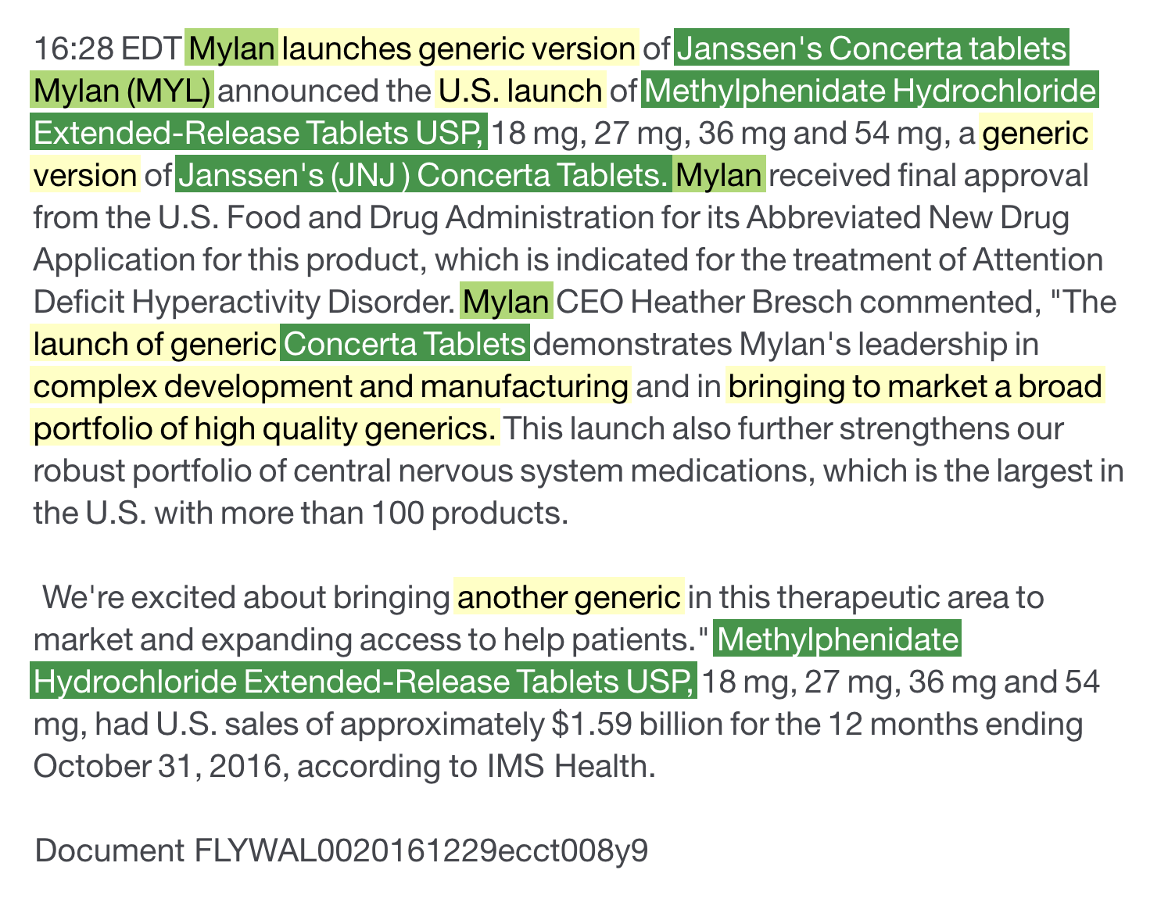
Sample Article
We want to know
Innovation Y/N
Product
Company
Competitors
Notes:
Replace this with highlighted article
New slide for future directions
Primary Goal
Produce classification method to identify articles as describing innovation or not.
Secondary Goal
Determine degree of innovation
Identify products and companies associated with innovations

Slide 33

Future Direction
Data
Explore
Transform
Sample
Modeling
Bag of Words
Support Vector Machines
Neural Network
Journal "PageRank"
Notes:
Mac - Homebrew
Windows - nothing

Slide 34
Defining and Measuring the Universe of
Open Source Software Innovation
Gizem Korkmaz, Bayoan Calderon, Cong Cong, Eliza Tobin, Calvin Isch
Sponsor: Carol Robbins, National Science Foundation, National Center for Science and Engineering Statistics
Notes:
Carol Robbins sponsor
NOTES: graphics are fuzzy
Go into copyright v license
Annual report: metrics?

Slide 35

Overview
Open Source Software (OSS): "a computer software, with its source code made available with a license, in which the copyright holder provides the rights to study, change, and distribute the software to anyone and for any purpose." (Open Source Initiative)
Notes:
Defining and measuring the universe of ope source software innovation: What is OSS? What is a universe?
Universe: scope right now is U.S. even though we acknowledge that OSS often has no boundaries – relevant to the issue of economic measurement in U.S. so focusing on that right now
NOTES: is copyright a good measurement of OSS innovation?
-add foreign sector
Software License: "A software license tells others what they can and can't do with your source code" (Github)

Slide 36

Overview Continued
Issue: There are no commonly used metrics to measure the amount of open source software (OSS) in existence and OSS is not captured in the nation's gross domestic product (GDP)
Goals:
Amount in existence
Longitudinal comparisons
Identify developers (who creates OSS?)
Measure research output of OSS by sector
Universe: All registered open source software
Notes:
ISSUE:
current economic indicators do not measure the value of goods and services that do not have market transactions
not captured in surveys nor are in economics measures such as the Gross Domestic Product (GDP).
Want a fuller understanding of innovation/OSS innovation
GOALS
Measure the amount of OSS data in existence, especially for purposes of longitudinal comparison
Origin: who creates OSS? What is distribution across different groups? - identify 5 sectors: we care because business OSS
OSS is a type of research output (there is money going into this but OSS is not captured when we look at the ROI on these projects) that comes not only from businesses but other sectors: important to gain a better understanding of this type of research output

Slide 37


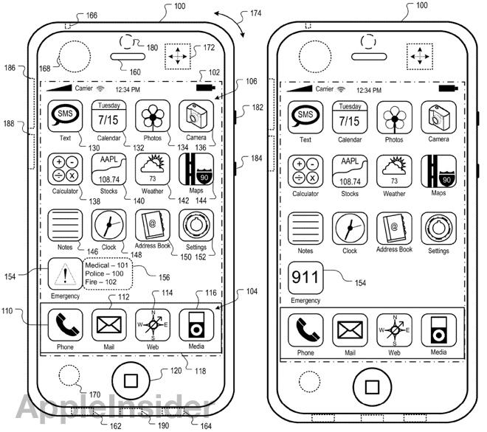
Data Discovery
Licenses define limitations of use
Product registration: provides developers with claims when licenses are violated
Three traditional ways to register innovation:
Copyright
Trademark
Patent
Notes:
People have licenses to define limitations of how other people can use their software (terms of use), people also register the products so that people can have claims when licenses are violated... there are 3 traditional ways to register innovation
3 typical ways to register innovation/products --> 3 traditional ways innovation is measured: copyright, trademark, patent

Slide 38

Copyright Data Discovery
First step: investigate software copyrighted in U.S.
Copyright: "a form of protection provided by the laws of the United States to the authors of ‘original works of authorship’ that are fixed in a tangible form of expression” (U.S. Copyright Office)
Why?
Accessible
Some copyrighted computer files are OSS
Is Copyright a Good Measure of the Universe of OSS?
Notes:
Decided to look at computer file copyright on copyright.gov because it is accessible – will look at the other two next
Some copyrighted computer files are OSS
Good way to measure universe of OSS?
Also wanted to see if computer file copyright was a good way to measure OSS innovation – is computer file copyright a good candidate for our universe?

Slide 39

Copyright Data Description & Collection
Data Scraping:
U.S. Copyright Office through Library of Congress
Program: For every year, visits every page of copyright data in order to retrieve the HTML elements of all "computer files"
2000 – 2014
110,650 copyrights scraped
Put data into our database
Notes:
Program written that, for each year, visits every page of copyright data and scrapes the elements (EX. Title, copyright claimant as seen below)
First started with data scraping of computer files from the U.S. copyright office
Extracted data from the U.S. copyright office website
Program written that, for each year, visits every page of copyright data and scrapes the elements (EX. Title, copyright claimant as seen below)
Put into our database

Slide 40
Copyright Data Exploration
Can we identify sectors that developed software?
Can we identify OSS in the computer file copyrights?
Are copyrights a good measure of the OSS universe?
Copyrights
Computer
files
OSS

Slide 41
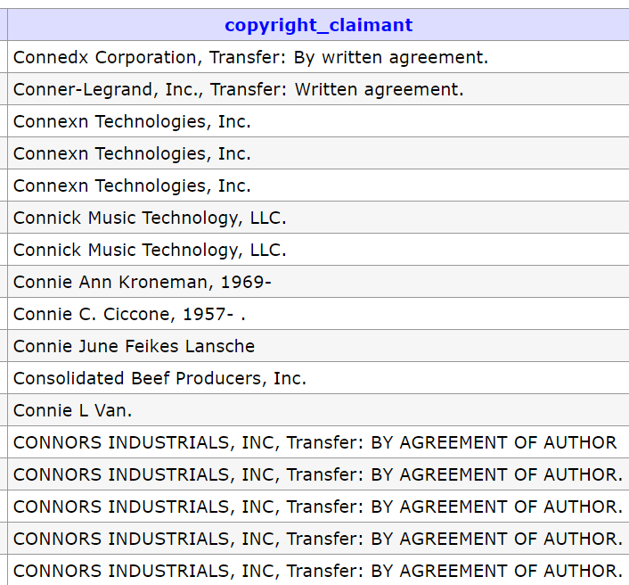
Copyright Claimants Categorization
Can we identify sectors who file the copyright?
Names of claimants in the copyright data
Notes:
Unidentified and overlaps

Slide 42
Copyright Claimants Categorization
Can we identify sectors who file the copyright?
Names of claimants in the copyright data
Business
Notes:
Unidentified and overlaps

Slide 43
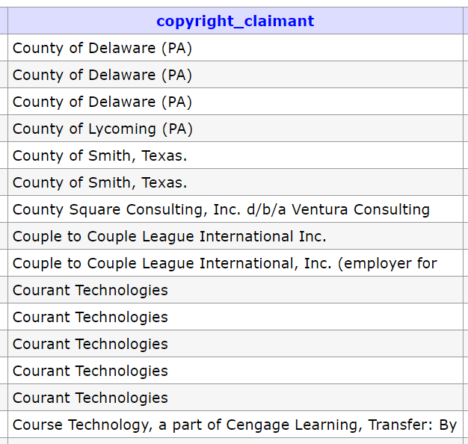
Copyright Claimants Categorization
Can we identify sectors who file the copyright?
Names of claimants in the copyright data
Government
Notes:
Unidentified and overlaps

Slide 44
Copyright Claimants Categorization
Can we identify sectors who file the copyright?
Names of claimants in the copyright data
Individual
Notes:
Unidentified and overlaps

Slide 45
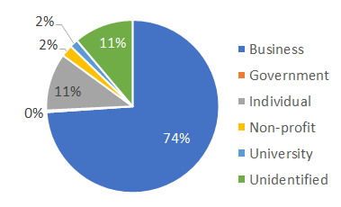
Copyright Claimants Categorization
Identified sectors for 81% of copyright claimants
98% accuracy based on random check
Sector Categorization:
Business
Government
Nonprofits
Universities
Individuals
Foreign
0.3%
Business is the largest sector in copyright records
Notes:
Unidentified and overlaps

Slide 46
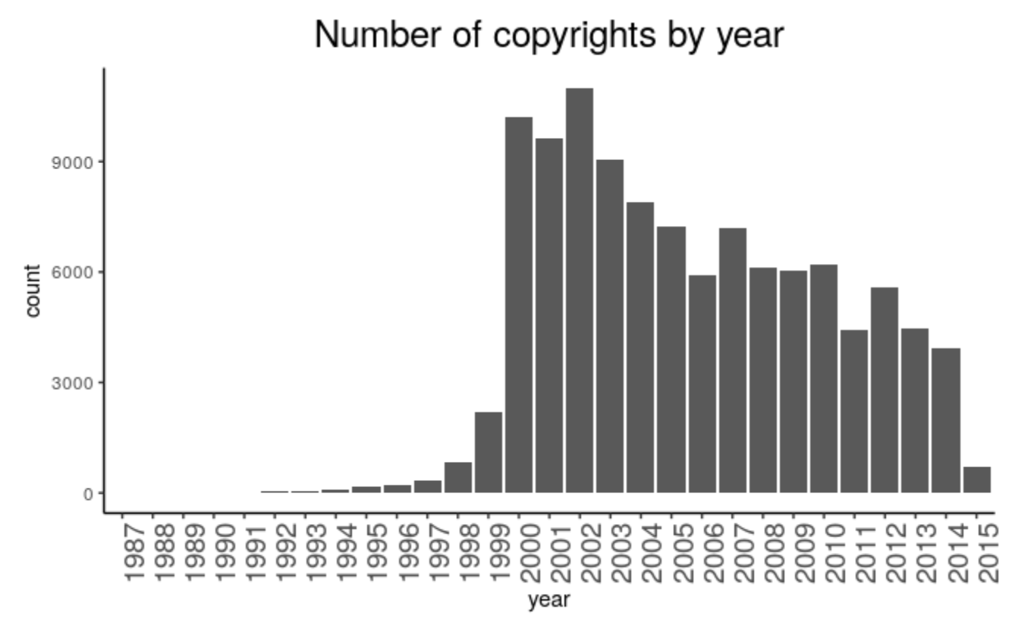
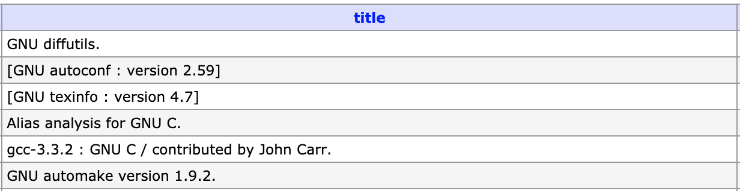
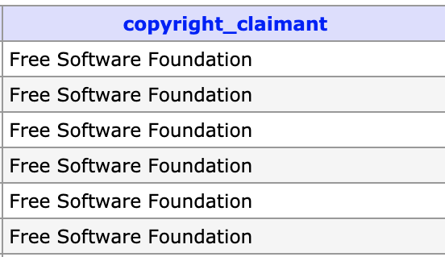
Findings:
Difficulties finding OSS in the decreasing copyrights
Identifying OSS in the data
Queried the database for OSS-identifiable characteristics
Typical terms: "OSS", "Free Software"
Licenses: MIT, APACHE, BSD, GNU, GPL
Large Programs: R, Python, Android
55
The number of computer-file copyright applications is decreasing
Identified so far
Notes:
Give examples of some of the identified OSS

Slide 47
Findings:
Difficulties finding OSS in the decreasing copyrights
Copyrights are NOT a good source for OSS
Identifying OSS in the data
Queried the database for OSS-identifiable characteristics
Typical terms: "OSS", "Free Software"
Licenses: MIT, APACHE, BSD, GNU, GPL
Large Programs: R, Python, Android
55
The number of computer-file copyright applications is decreasing
Identified so far
Notes:
Give examples of some of the identified OSS

Slide 48


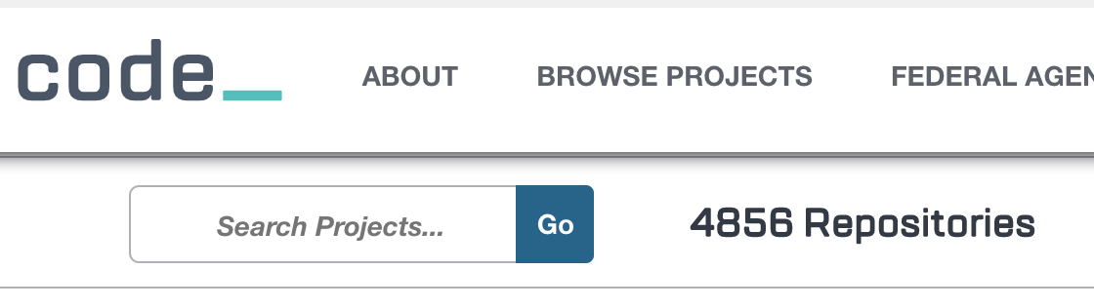
Challenges and Next Steps:
What about Patents and Trademarks?
Explore alternative data sources
Code.gov - Government OSS
Create government sector universe
Scrape their repos (GitHub, Bitbucket, SourceForge, etc.)
Redefine the universe
Perhaps registration is not a common practice—change definition of the universe
GitHub repositories with OSI-approved licenses
Notes:
Other sources don't have equal coverage—and ethics
uspto

Slide 49
Defining and Measuring the Universe of
Open Source Software Innovation
THANK YOU
QUESTIONS?
Notes:
Carol Robbins sponsor
NOTES: graphics are fuzzy
Go into copyright v license
Annual report: metrics?

Slide 50
Measuring the Federal (Public) Funding of
Research & Development Projects Using Administrative Data
SDAD DSPG Team: Alyssa Fowers, Sean Pietrowicz, Joel Thurston, Stephanie Shipp
Sponsor: John Jankowski. R&D Statistics Program, National Center for Science & Engineering Statistics. National Science Foundation
June 28, 2019

Slide 51
Project Summary and Goals
Enhancing or supplementing research and development data
NSF National Center for Science & Engineering Statistics (NCSES) survey (census) data with publicly available administrative data
Providing International Standards for Science, Technology, Innovation (STI) Data
Organisation for Economic Co-operation and Development (OECD) - National Experts on Science and Technology Indicators (NESTI): – our NSF sponsor chairs this working group
Why this matters
Tracking funding to the project level will allow detailed analysis of R&D funding (fields of study, amount of funding, other)
Goals
Document availability and quality of administrative data to measure public R&D expenditures across federal agencies using a common template.
Assess feasibility of building a micro database of public funding for R&D projects based on administrative data
Notes:
Focus on enhancing or supplementing the NSF National Center for Science & Engineering Statistics (NCSES) survey data with publicly available administrative data to better measure public research and development (R&D) projects.
Also of interest to OECD-NESTI: Providing International Standards for Science, Technology, Innovation (STI) Data – our sponsor chairs this working group
Why this matters:
Although federal funding information of public R&D is documented until the agency level, tracking funding to the project level will allow analysis of projects (fields of study, amount of funding, other)
Goals:
Provide documentation about public R&D expenditures across federal agencies using a common template.
Assess feasibility of building a micro database of public funding for R&D projects based on open and available administrative data
Federal R&D data is reported based on high-level, aggregated survey results, so it’s challenging to investigate specific research topics over time, e.g. how much funding is allocated to nanotechnology projects?
This project will allow the NCSES to learn about the feasibility of accessing and analyzing non-survey data about public R&D.
By consolidating screening and organizing R&D funding information into a common template, NCSES can analyze the extent of investment into specific scientific fields.

Slide 52
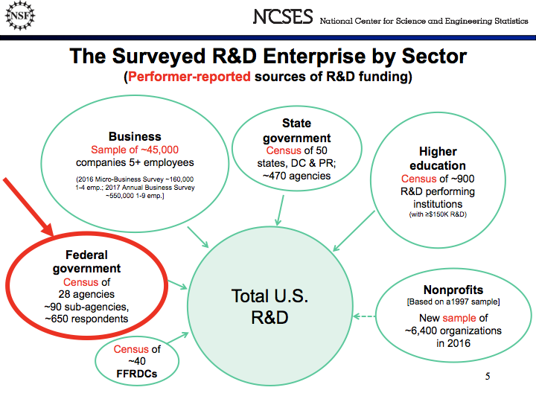
Notes:
The NSF collects data from all sectors about their sources of R&D funding. They collect this data using surveys and censuses. We are interested in assessing the feasibility of measuring federal public funding of R&D to universities and nonprofit organizations using administrative data in place of a survey of federal agencies. (In this case, it is actually a census because all agencies are included.)

Slide 53
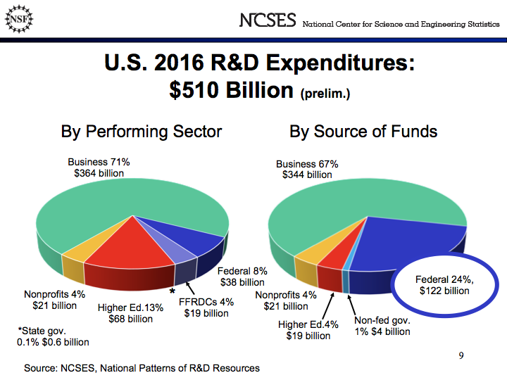
Notes:
We are focusing on measuring the Federal Sources of R&D funding which represents about almost 25% of all sources of R&D fundind or $122 billion.

Slide 54
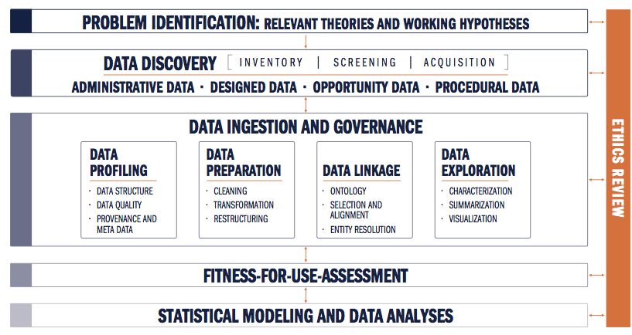
Ethical Review of Research
The data for this project are entirely available to the public and contains no confidential or classified information.
Because our goal is to document and organize already existing public information, there appears to be no potential for ethical conflicts in this project.

Slide 55














Data Discovery

Slide 56


NASA
Science Research Directorate | Aeronautics Research Mission Directorate | Human Explorations and Operations Mission Directive
Data Discovery: Departments and Agencies
Department of Energy
Office of Science
ARPA-E
Nuclear Energy
EERE
Office of Electricity
NIFA
ARS
Natural Resources
ERS
Department of Defense
DARPA
ONR
ARI
ARO
AFRL
AFOSR
CDMRP
Science Research
Aeronautics Research
Human Explorations
NCI
NEI
NHLBI
NHGRI
NIA
NIAAA
NIAID
NIAMS
NIDCD
NIDDK
NIDA
NIEHS
NIGMS
NIMH
NIMHD
NINDS
NINR
CIT
FIC
NCATS
NCCIH
NIBIB
NICHD
NLM
CC
CSR
NIDCR
BIO
CISE
EHR
ENG
ERE
GEO
OIA
OISE
MPS
SBE

Slide 57
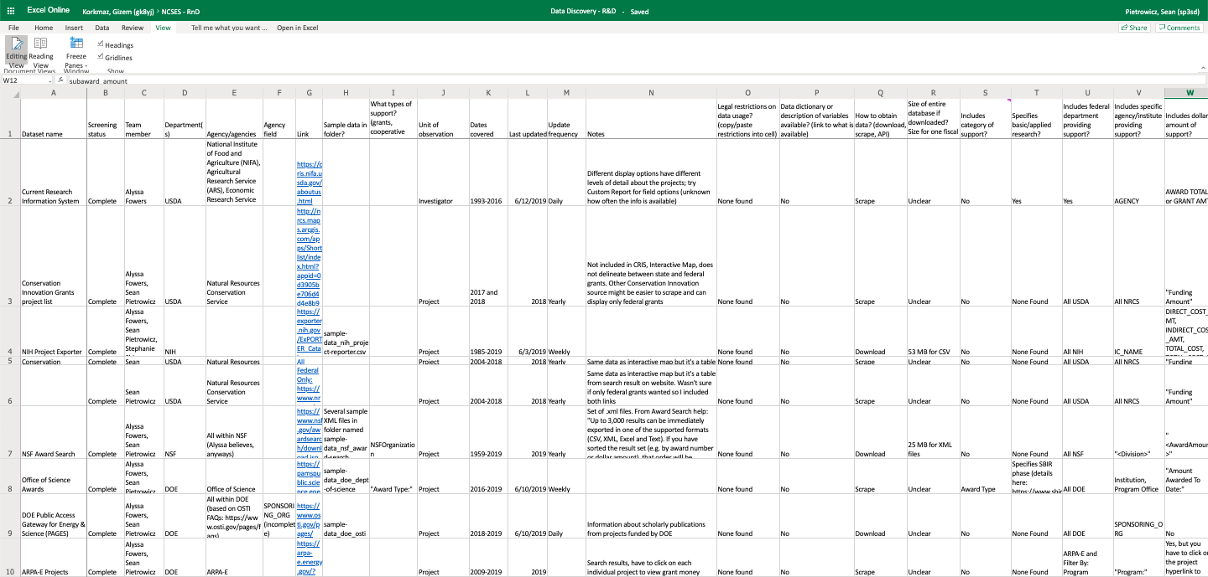
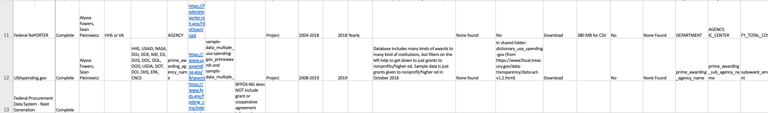
Data Discovery: Screening

Slide 58
Data Discovery: Screening
Asked 27 screening questions of 11 publicly available databases.
Good date coverage, some direct downloads available, detailed information about areas of inquiry and research institutions.
Ease of obtaining/ interpreting data
Matching to survey data
Basic information
Enabling detailed analysis
Grants vs cooperative agreements
Basic vs applied research
Start more detailed profiling with Federal RePORTER and USAspending.gov
Data dictionaries
Linked to publications
R&D vs general S&E
Institution type

Slide 59
Data Profiling
Assessing data quality:
Completeness: % of values that are not blank or NA
Value validity: % of values in the right format for information (e.g. dates in a date field, only actual state names in state fields, etc.)
What percentage of projects and funding is accounted for?
%, count, and total dollar amount of grants in each department, sub-agency and office - compare against the NSF Survey of Federal Science … Support (FSS)

Slide 60
Completeness
How much data are missing?
Created an automated process that returns percentages of complete (not N/A or blank) values for each field in the dataset
Especially relevant for tracking funding amounts and organization name
Frequency of Congressional District Entries
CONGRESSIONAL_DISTRICT | freq
07 | 12010
02 | 8733
01 | 7612
05 | 7228
N/A | 6560
03 | 6294
12 | 6125
04 | 4090
13 | 3874
09 | 3019

Slide 61
Validity
How much data are relevant and correctly formatted?
Specialized process for each field that tracks amount of incorrectly formatted and misplaced data.
Process returns the percentage of projects and funding inputted correctly
Prepared R scripts to:
Ensure proper formatting for
state abbreviations, zip codes and city names
DUNS numbers, CFDA codes and project IDs
author names, dates and funding totals
Examine each department, agency, state and country name to check valid classifications

Slide 62
Validity Example
Evaluated character lengths of project titles and noticed several entries that were much longer than expected
Revealed to contain project abstracts, not titles!
 | PROJECT_TITLE
1 | THE PROPOSED WORK CONTRIBUTES IN A SIGNIFICANT WAY BY CREATING A FORMAL LINK BETWEEN WEDC AND THE ELMIRA CITY SCHOOL DISTRICT THROUGH A NASA STEM EXHIBIT AND ASSOCIATED STEM CURRICULA. THE TARGETED AUDIENCE OF THE PROPOSED WORK IS GRADES K THROUGH 12 LOW
2 | PARTICULATE ORGANIC MATTER POM IN THE UPPER OCEAN IS SUBJECT TO ADVECTION BY NEAR SURFACE VELOCITIES RELATED TO THE DYNAMICS OF EDDIES, FRONTS AND MIXED LAYER INSTABILITIES. THIS ADVECTION INFLUENCES BOTH THE HORIZONTAL AND VERTICAL DISTRIBUTIONS OF POM.
3 | SCANNING TRANSMISSION ELECTRON MICROSCOPY OF LABORATORY SPACE WEATHERED PARTICLES THE GOAL OF THIS PROPOSAL IS TO CHARACTERIZE SPACE-WEATHERING EFFECTS AS A FUNCTION OF REGOLITH TEMPERATURE, ENERGY SOURCE AND VOLATILE CONTENT BY SCANNING TRANSMISSION ELE
4 | SCIENCE GOALS AND OBJECTIVES: THE SCIENTIFIC OBJECTIVE OF THIS EFFORT IS TO DEVELOP A BETTER UNDERSTANDING OF ELECTROMAGNETIC SCATTERING FROM PLANETARY SURFACES USING THEORY AND COMPUTER SIMULATIONS. ONE GOAL IS TO UNDERSTAND HOW THE AMPLITUDE AND POLARI
5 | UNDERSTANDING AND FORECASTING CHANGES IN HIGH MOUNTAIN ASIA SNOW HYDROLOGY VIA A NOVEL BAYESIAN REANALYSIS AND MODELINGAPPROACH SEASONAL SNOW OVER HIGH MOUNTAIN ASIA (HMA) CONSTITUTES ONE OF THE MOST IMPORTANT COMPONENTS OF THE REGIONAL HYDROLOGIC CYCLE,

Slide 63
Profiling Fed RePORTER
Dataset with 91,151 entries and 24 fields of information
Initial profiling of 2016 sample data
Preliminary results of profiling
Completeness: Average field was 86.8% complete
Validity: Average field was 85.1%, but some fields were too qualitative to evaluate e.g. PROJECT_TERMS below
These high completeness and validity results are very promising.
Behavior; Bioinformatics; Biological Assay; Biomedical Research; Biometry; Child; Clinical; cognitive testing; Communities; Cytogenetics; Data Analyses; design; Developmental Disabilities; developmental disease/disorder; Diffusion; Functional Magnetic Resonance Imaging; Funding; Gap Junctions; Genetic; Histology; Image; Impairment; Institutes; Institution; Institutional Review Boards; Intellectual functioning disability; Leadership; lectures; Magnetic Resonance Imaging; Mental Retardation and Developmental Disabilities Research Centers; Methods; Molecular Genetics; Motor; multidisciplinary; National Institute of Child Health and Human Development; neuroimaging; neuropsychological; Participant; Pathway interactions; pre-clinical; Prevention; programs; Protocols documentation; Research; Research Personnel; response; Risk; School-Age Population; Science; tissue culture; Training; translational neuroscience; Translational Research; Universities

Slide 64
NASA
Science Research Directorate | Aeronautics Research Mission Directorate | Human Explorations and Operations Mission Directive
Initial FedREPORTER Profiling Results
field | completeness | validity
PROJECT_ID | 100.00000 | 100.00000
PROJECT_TERMS | 99.99890 | NA
PROJECT_TITLE | 100.00000 | 98.55295
DEPARTMENT | 100.00000 | 100.00000
AGENCY | 100.00000 | 100.00000
IC_CENTER | 79.93659 | 79.93659
PROJECT_NUMBER | 100.00000 | 82.27008
PROJECT_START_DATE | 86.59367 | 86.59367
PROJECT_END_DATE | 87.28264 | 87.28264
CONTACT_PI_PROJECT_LEADER | 99.99122 | 99.75425
OTHER_PIS | 17.33058 | 17.32839
CONGRESSIONAL_DISTRICT | 92.80315 | 87.81473
DUNS_NUMBER | 99.44597 | 99.44378
ORGANIZATION_NAME | 99.98793 | 99.98793
ORGANIZATION_CITY | 99.78497 | 99.78497
ORGANIZATION_STATE | 98.77456 | 98.76359
ORGANIZATION_ZIP | 95.94738 | 95.09824
ORGANIZATION_COUNTRY | 99.86616 | 99.86616
BUDGET_START_DATE | 74.25152 | 74.25152
CFDA_CODE | 82.32493 | 80.26242
FY | 100.00000 | 100.00000
FY_TOTAL_COST | 83.55037 | 83.43298
FY_TOTAL_COST_SUB_PROJECTS | 12.24123 | 12.17869

Slide 65
NASA
Science Research Directorate | Aeronautics Research Mission Directorate | Human Explorations and Operations Mission Directive
Data Discovery: Fed RePORTER Coverage
Blue boxes are included in Fed RePORTER; gray boxes are not included.
Department of Energy
Office of Science
ARPA-E
Nuclear Energy
EERE
Office of Electricity
NIFA
ARS
Natural Resources
ERS
Department of Defense
DARPA
ONR
ARI
ARO
AFRL
AFOSR
CDMRP
Science Research
Aeronautics Research
Human Explorations
NIH: includes grant information but not funding amounts
NCI
NEI
NHLBI
NHGRI
NIA
NIAAA
NIAID
NIAMS
NIDCD
NIDDK
NIDA
NIEHS
NIGMS
NIMH
NIMHD
NINDS
NINR
CIT
FIC
NCATS
NCCIH
NIBIB
NICHD
NLM
CC
CSR
NIDCR
NSF: includes grant information but not funding amounts, does not specify directorates
BIO
CISE
EHR
ENG
ERE
GEO
OIA
OISE
MPS
SBE

Slide 66
Next Steps
Complete FEDREPORTER and benchmark to NSF NCSES Survey of Federal Science and Engineering Support to Universities, Colleges, and Nonprofit Institutions (FSS)
Profile and benchmark USA Spending and NIH Exporter
Evaluate: do we need to profile other databases?
Create data dictionary to connect information from different agencies
Write Sage Social Science brief(s)

Slide 67
Army Research Institute
Measuring Community Embeddedness Near Army Installations: A Feasibility Study
DSPG Team: Jessica Keast, Sean Pietrowicz, Allegra Pocinki
SDAD Team: Stephanie Shipp, Joel Thurston, Advisors: Vicki Lancaster, Josh Goldstein, Nathaniel Ratcliff
Sponsor: Kelly Ervin, US Army Research Institute for Social and Behavioral Research
June 28, 2019

Slide 68
Community Embeddedness
“Community embeddedness refers to the attachments an individual worker maintains in a given area” (Munyon et al. 2019)
This project conceptualizes embeddedness as the degree to which Soldiers are connected (or disconnected) to the larger community and nation that they serve
Munyon, T. P., Madden, L. T., Madden, T. M., & Vigoda-Gadot, E. (2019). (Dys)functional attachments?: How community embeddedness impacts workers during and after long-term unemployment. Journal of Vocational Behavior,112, 35-50. doi:10.1016/j.jvb.2019.01.005
Notes:
Jessica

Slide 69
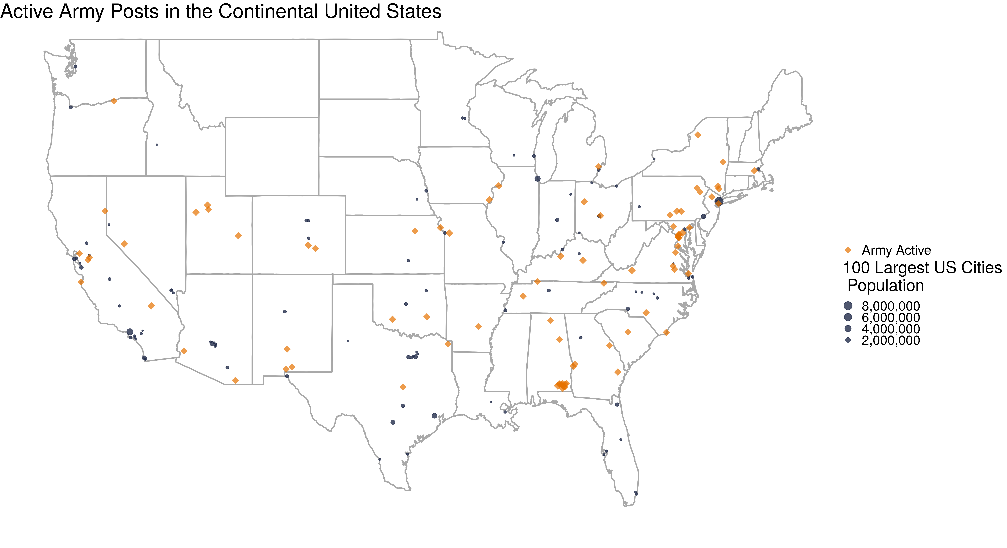
Project Summary
Project goal: Define and create composite indicators for community embeddedness
Why does community embeddedness matter to the Army?​
The ARI-SDAD collaboration seeks to understand the relationship between the Soldier’s community and Soldier performance and behavior​
Notes:
We are focusing on measuring the Federal Sources of R&D funding which represents about almost 25% of all sources of R&D fundind or $122 billion.

Slide 70
Research Questions
What is community embeddedness, and what characteristics of a community promote embeddedness? (from indicators and social media)
How does community embeddedness vary across locations? (from indicators)
Notes:
Jessica

Slide 71
Value to the Army
Community embeddedness may serve as an antecedent or enabler of Soldiers' development, reflecting the degree to which Soldiers have internalized core qualities of interest to the Army, such as:
Army Values (Selfless Service)
Soldier's Creed
“I am an American Soldier...
I serve the people of the United States, and live the Army Values...
I am a guardian of freedom and the American way of life”
Soldiers' health outcomes could potentially parallel community outcomes
Soldiers may also be found to be more susceptible to negative outcomes associated with embeddedness to the degree that Soldiers differ from the larger population

Slide 72
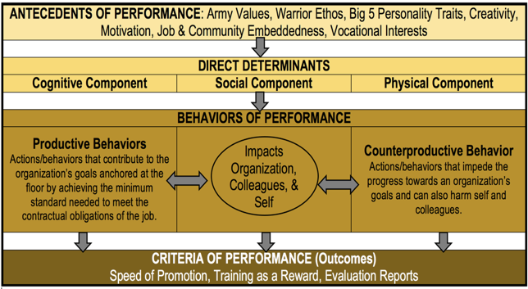
Conceptual Model of Performance & Behavioral Data Mapping
Notes:
SDAD is conducting research using multiple sources of DOD and Army data to create constructs to measure performance and behaviors.
This summer, we are working on one aspect of this measurement: How is community embeddedness defined? What are factors that define community embeddedness? If we can measure this, then we may include measures of community embeddedness in the constructs (the larger SDAD project)

Slide 73
Ethical Review
Problem Identification (Relevant Theories and Working Hypotheses)
Expected benefits: quantifying a social construct (community embeddedness) that isn’t currently measured for each county; no potential risks to participant welfare.
Assumptions: What characterizes a "good" or "embedded" community
Addressing these concerns by following common indicators already used in practice as well as controlling for race and income.
The IRB for this project has already been created and approved.
Data Discovery, Inventory, Screening, & Acquisition
Using data that has been sampled to represent the population and plan to apply survey weights.
Social media data might disproportionately skew towards younger individuals and those with higher education and income who have regular, reliable access to the internet.

Slide 74
Literature Review
An investigation into previous literature on embeddedness revealed several insights:
Previous studies collected survey data to measure job embeddedness and community embeddedness – using existing data
Previous studies focused on people in high turnover fields with many competitors
Grocery stores, hospitals are not analogous to the Army (interest in industry alternatives, networking behavior, employment shocks)
Overarching idea of community embeddedness remain relevant: social links made within an individual's community, quality of community fit, sacrifices made to live in community.
Without individual Soldier data, we are measuring overall community involvement around Army posts as a proxy for how involved Soldiers can become in these communities.
Notes:
An investigation into previous literature on this field of embeddedness revealed several insights:
Job embeddedness and community embeddedness have been calculated in previous studies from survey data collected for these specific studies. Our goal to create a metric using existing publicly available data will require a different approach.
Previous studies have interviewed employees of industries with high turnover and many competitors (grocery stores, hospitals, etc.). One's propensity to leave a high-turnover industry has been measured with several metrics that do not translate (interest in industry alternatives, networking behavior, employment shocks).
Overarching concepts of community embeddedness remain relevant: social links made within an individual's community, quality of community fit, sacrifices made to live in community. We sought to capture the spirit of these categories while utilizing publicly available data sources.
Without individual soldier data, we cannot apply the techniques developed by previous papers to measure embeddedness. Instead, we are measuring overall community involvement around Army posts as a proxy for how involved soldiers can become in these communities. Maximizing the appropriateness of this measure will be a primary challenge of this project.

Slide 75
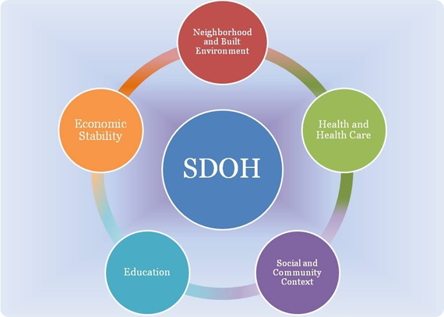
Research – Two Parts
1. Calculate indicators for counties in 2 states aligned with Social Determinants of Health
Compare community embeddedness indicators for all counties in Virginia with those counties that have Army posts
Compare differences between states (Oklahoma and Virginia)
Challenge – how to weight components of indicators?
2. Use social media data to supplement findings
Using ideas from indicators, search for terms related to community embeddedness
Challenge – Twitter requires approvals to obtain data; currently using blogs
Social Determinants of Health Framework
Source: https://www.healthypeople.gov/2020/topics-objectives/topic/social-determinants-of-health

Slide 76
Ideas for Community Embeddedness Composite Indicators
Neighborhood and Built Environment
housing characteristics: age, overcrowding, high housing costs, lack of kitchen/plumbing facilities
homeowners vs. renters
crime rates
air/water quality
residential segregation
commute time/distance
Open Street Maps: open space, sidewalks, playgrounds, parks
Health and Health Care
primary care physicians
teen births
infant/child mortality
preventable hospital admissions
insurance coverage
drug overdose deaths
reports of poor/fair health
Open Street Maps: liquor stores, fast food restaurants, fitness centers
Economic Stability
poverty status
employment status
income inequality
median income
food insecurity
Education
highest level of educational attainment
on-time high school graduation rate
early childhood education enrollment
Social and Community Context
membership associations
voting rate
racial/ethnic diversity
marriage rates
family size
library patronage
foster care entry
Open Street Maps: community centers, museums, religious institutions
Notes:
We are focusing on measuring the Federal Sources of R&D funding which represents about almost 25% of all sources of R&D fundind or $122 billion.

Slide 77
Data Discovery
Data source | Measures | Challenges | Keep/Shelve
American Community Survey | Social, economic, housing, and demographic characteristics | None | Keep
Virginia Department of Health, Injury & Violence | Deaths due to injury and violence | Have to request CSV files directly from Virginia Department of Health | Keep
County Health Rankings | Health outcomes, health behavior, socioeconomic factors, physical environment | None | Keep
Election Turnout, Individual Elections (Virginia) | Voter turnout data for general and special elections | None | Keep
Kids Count Data Center | Demographic indicators, economic well-being, education, health, safety for children | None | Keep
Public Libraries Survey | Public libraries within the U.S. | None | Keep
Open Street Maps | Location of various buildings and resources (e.g., open space, sidewalks, playgrounds, parks) | None | Keep
Notes:
We are focusing on measuring the Federal Sources of R&D funding which represents about almost 25% of all sources of R&D fundind or $122 billion.

Slide 78
Data Discovery
Data source | Measures | Challenges | Keep/Shelve
Number of Crimes by Offense Type (Virginia State Police) | Crimes by offense type, drug reports, hate crimes | Decent amount of missing data | TBD
General Social Survey (GSS) | Trends in attitudes, behaviors | Under contract, the GSS will provide data on State, PSU, County, Census tract. | Shelve, but are pursuing for future research
American Time Use Survey | How people spend their time on various activities including religious activities, socializing, unpaid childcare, housework, volunteering, etc. | Only national-level data | Shelve
Behavioral Risk Factor Surveillance System (BRFSS) | Health indicators | No county data – just state, metropolitan status | Shelve
National Health and Nutrition Examination Survey (NHANES) | Health and nutritional status of adults and children | All geography below national level is restricted. | Shelve
Department of Defense Education Activity (DoDEA) | Regional school calendars, enrollment data, accreditation reports, comprehensive assessment system, school report system | Lots of missing data for schools, no DoDEA schools near Army bases in Virginia | Shelve
Virginia Department of Health, Health Behavior | Health behaviors by health district | Geography grouped into health districts, which don’t correspond to any Census measure | Shelve
Notes:
We are focusing on measuring the Federal Sources of R&D funding which represents about almost 25% of all sources of R&D fundind or $122 billion.

Slide 79
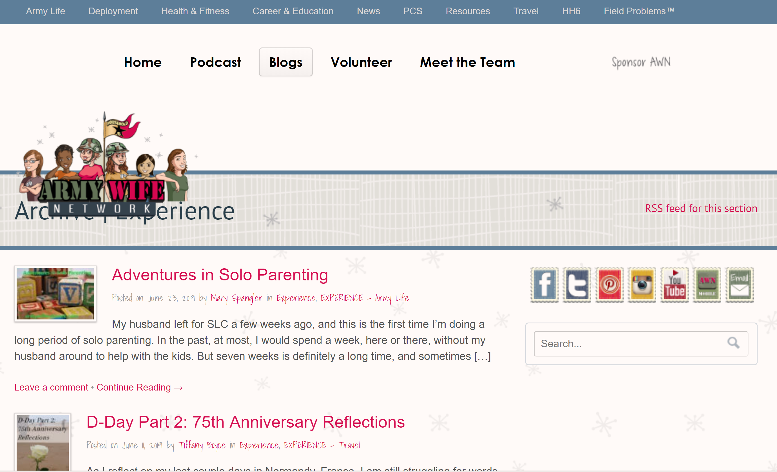
Social Media Sentiment Analysis
Interested in how often posts to social media are positive or negative
Identify keywords to search for discussions of community, social cohesion, what specific Army posts are being discussed

Slide 80
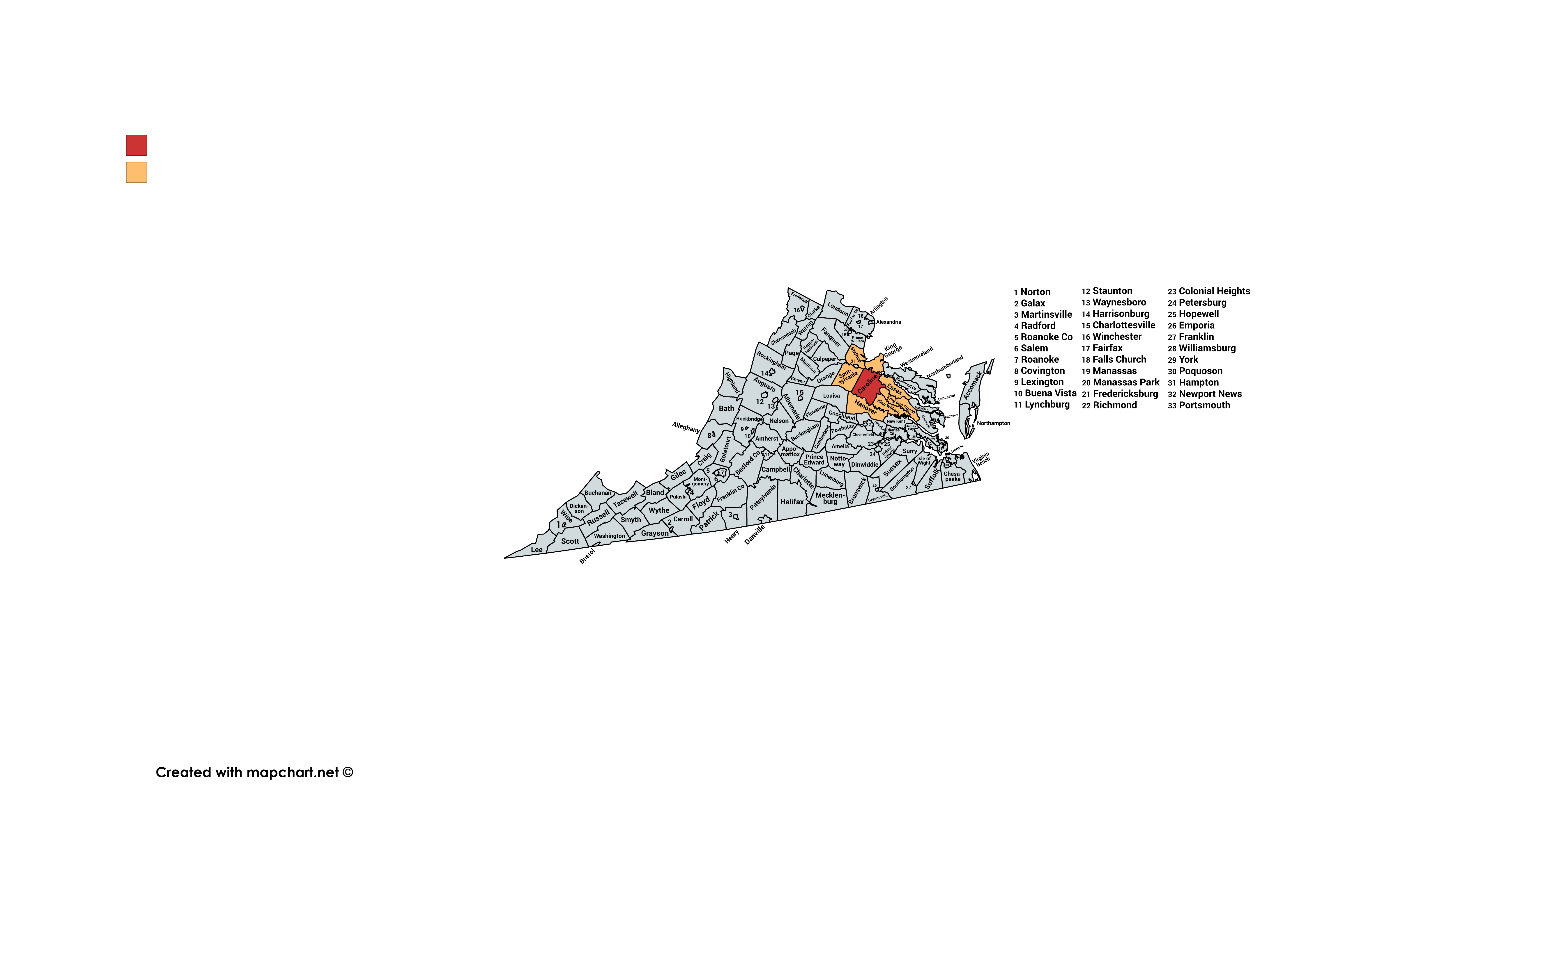
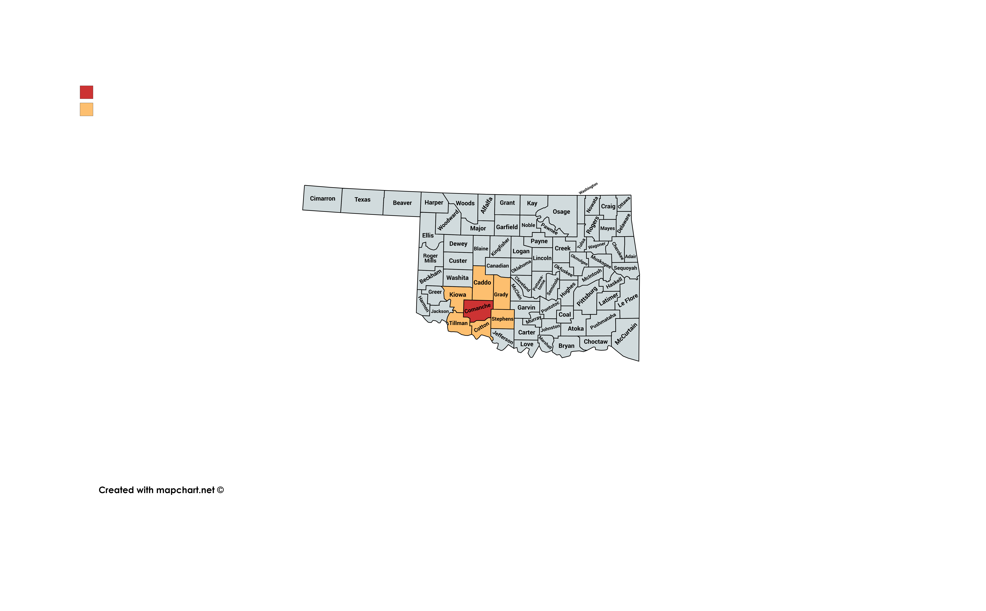
Army Post and County Selection
Ft. AP Hill (Virginia, Caroline County): Regional Collective Training Center; military units from across the U.S. are sent here for training
Ft. Sill (Oklahoma, Comanche County): home to the Field Artillery Training Command – all soldiers in Field Artillery receive their skills training here

Slide 81
Next Steps
1. Calculate indicators for counties in Virginia and Oklahoma
Create indicators using variety of data sources (American Community Survey, County Health Rankings, Open Source Maps, others)
Compare and analyze results within a state and between the two states
Determine weights (how were they calculated for County Health Rankings?)
2. Use social media data to supplement findings
Obtain data (likely blogs, maybe Twitter)
Identify keywords; conduct sentiment analysis; visualize results
Summarize findings - determine what types of discussions people are having about the Army and how they relate to community embeddedness

Slide 82
Appendix A: BRFSS and DoDEA Data
Why can’t we use these data sources for this project?
Behavioral Risk Factor Surveillance System (BRFSS): no county-level data; data available by state or metropolitan status (city, MSA, suburb, rural), which does not accurately encapsulate the area around each Army post.
DoDEA:
Regional school calendars shows the opening/closing dates for each school as well as holiday closings
Enrollment data provides total number of students in each grade, but there are no DoDEA schools in Virginia
Comprehensive assessment system provides average test scores/percentiles per school, missing data for many schools
Annual school report system provides performance data for Terra Nova exam, missing data for many schools
Accreditation reports are PDFs for each school that list criticisms of schools/areas for improvement, missing data for many schools (text could be useful for content analysis)
Notes:
Q – how does County Health Rankings use these data? We don't know – it just says they use BRFSS as a source, but you can't get any lower than MMSA. All we know is from BRFSS: A county name was collected from the respondent during the demographics section of the interview. The name of the county was used to determine the corresponding American National Standards Institute (ANSI) county code; this code was retained as a variable in the data set. The data record from an interview with a respondent was assigned to an MMSA on the basis of the county code.
https://www.cdc.gov/brfss/annual_data/2017/pdf/2017_SMART_BRFSS_MMSA_Methodology-508.pdf

Slide 83
Social Determinants of Health and Composite Indices for a
Fairfax CommunityScapes,
Interim Review
Data Science for the Public Good team: Cong Cong, Quinton Neville, Victoria Halewicz, Eliza Tobin
Social & Analytics Division Team: Teja Pristavec (lead), Josh Goldstein, Stephanie Shipp, Joy Tobin, Sallie Keller
Sponsors: Michelle Gregory and Sophia Dutton, Fairfax County Health and Human Services; Kathi Huddleston, Sahel Hazrati, and Grace Lawrence, Inova Translational Medicine Institute
June 28, 2019
Notes:
Font size: 40 title; 28 big points, 20 everything else; color: dark blue, text 2
Notes: Synthetic data use and geographic scope ** put this somewhere

Slide 84
Introduction
Goal: Map social determinants of health that influence wellbeing in Fairfax County
Social Determinants of Health: "The social determinants of health (SDH) are the conditions in which people are born, grow, work, live, and age, and the wider set of forces and systems shaping the conditions of daily life."
Reasoning:
Health inequities in Fairfax County
Where? Why?
What can be done?
Little information at the subcounty level: only at the county level
Understanding how to adequately allocate resources
Establish a baseline measurement for future policy changes
Notes:
Eliza
Determine socioeconomic and environmental factors that influence obesity in Fairfax County [[by investigating where residents live, learn, work, and frequent]]
Developing these indices as a broader goal of creating fairfax county community scape
Community scape: collection of indices which describe where citizens live, work and play – starting to build community scape
Lower level of geography
Conditions, lived, built environment that influences people's health outcomes
Want information to be actionable at – need more geographic information to be actionable
Mapping of vulnerable populations
will establish a baseline for measuring future change for new policies and practices across the county.
Why?
NOTES
Specify equity (environmental equity?)
Motivating need for composite index: why are they useful for us?

Slide 85



Process Overview
Select Composite Indices
Set of variables that we cannot observe but that we want to describe
EX. Health, quality of life, happiness
Chosen Indices
Economic Vulnerability
Obesogenic Environments
Quality
of
Life
Measurable Variables
Notes:
Characterize community scape of fairfax county by building these composite indices
Subcounty
Creation of composite indices for the purpose of quantitatively contextualizing social determinants of health and wealth that impact resident's risk of obesity
“Technically speaking an indicator refers to a set of statistics that serve as a proxy or metaphor for phenomena that are not directly measureable.”
Example – Health, quality of life, happiness, etc.
Motivation
Literature review
Relevant to current initiatives and frameworks and stakeholders' priorities

Slide 86


Literature Review
Examples of Insights
Educational attainment —> reliable socioeconomic status measure
Parental education/income —> children's physical activity
Walkability scores —> elderly fitness
Notes:
Notes: image is too small
Reaggregation census estimates at new geographies by combining the community survey and housing stock data

Slide 87



Data Sources
OpenStreetMap
Notes:
Teja: Order of these slides?
ACS: import, reliable demographic information
Fairfax county housing stock: locations of where people live in the County, distribution of housing types, etc.
OSM: crowdsourced resource kind of like google maps, updated daily, gives map of various environmental factors in different areas (s.a. restaurants, bars, parks, etc.) -- spatial wikipedia
Used this as opposed to official fairfax county mapping data because the official data did not have locations of various variables that we wanted to look at

Slide 88

American Community Survey
Bi-annual national survey
5-year estimate at Census block level
Demographic and Socioeconomic data
Notes:
Notes: don't use this image

Slide 89
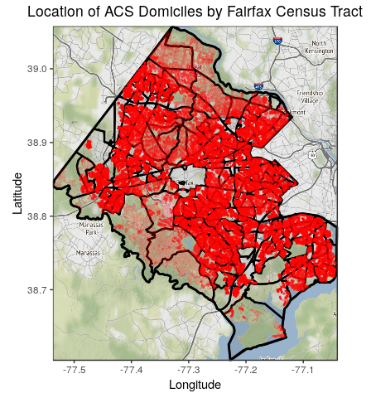
Fairfax Housing Stock Data
Synthetic population generation​
Reaggregated to Census tracts, supervisor districts, and school districts​
Notes:
Make sure to introduce Graphics
Because they are geographic units of interested for the sponsor

Slide 90
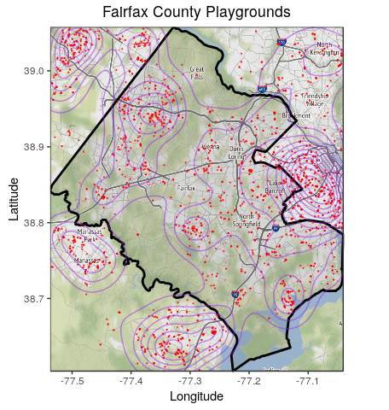
Open Street Maps: Data Discovery
Notes:
Introduce in detail what each graphic is, how it's oriented, and what the specific points, lines (contours), and areas are. Also make sure to note that this is a visualization of the spatial data we obtained from OSM.

Slide 91
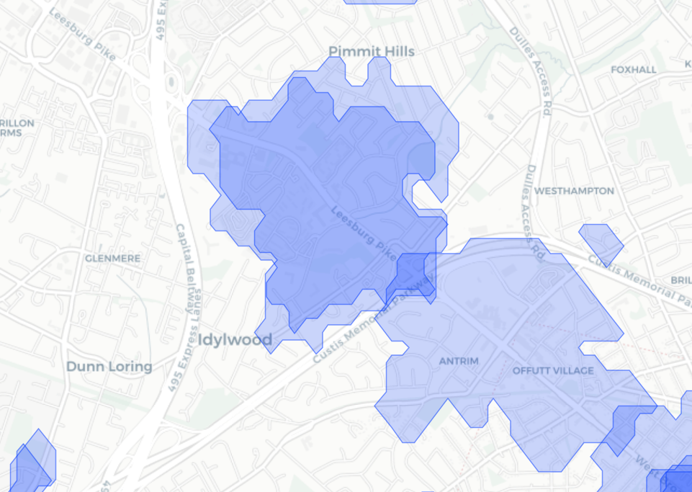
Travel Time Example
20 Minute Travel Area by Bus
Households
Supermarket
http://rpubs.com/ccong2/508061
Notes:
Notes
Need more information

Slide 92

Index 1: Economic Vulnerability
Income
Education
Age
Race
Ethnicity
Supplemental Security Income
Public Assistance Income
English Fluency
Poverty
Commute time to work

Slide 93


Index 2: Obesogenic Environments
Fast food
Supermarkets
Convenience Stores, Green Grocers
Restaurants
Gas Stations
Alcohol Stores, Bars, Pubs
Nature Reserves
Parks
Fitness Centers
Playgrounds
Notes:
Eliza
not ready to capture dimensionality about it yet, but Trying to capture two dimensions of this right now: food environment, physical environment;
-don't have to read all of factors

Slide 94

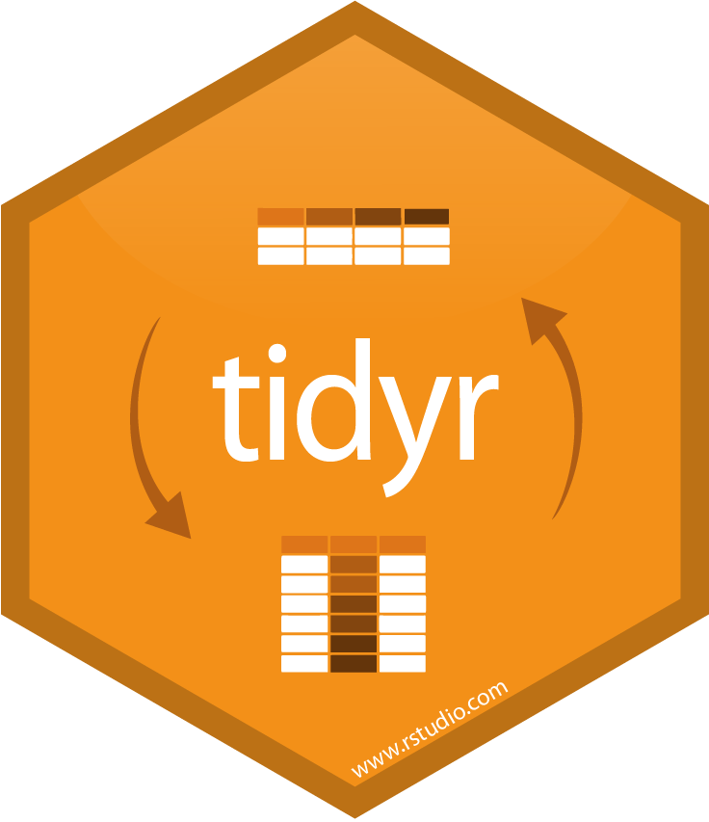



Looking Ahead
Data
Explore ACS synthetic data
Join multiple sources
ACS, Housing, OSM
Create travel-time distance
SES
https://www.tidyverse.org
Index Construction
Dimensional / Factor Analysis
Weighting & Aggregation
Interactive Visualization
Variables
Food +/-
Obesogenic
Index
Geo

Slide 95
USDA Economic Research Service:
Validating FCC Broadband Data & Identifying Factors That Affect Property Values
Data Science for the Public Good team: Kat Savchyn, Sarah McDonald, Raghav Sawhney
Social & Analytics Division: Team: Teja Pristavec, Josh Goldstein, Stephanie Shipp,
Sponsors: John Pender, Peter Hahn, Zachary Keeler, USDA ERS
June 28, 2019
Notes:
Font size: 40 title; 28 big points, 20 everything else; color: dark blue, text 2
Notes: Synthetic data use and geographic scope ** put this somewhere

Slide 96

Agenda
Project Overview
Timeline & Status Overview
Literature Review
Data Inventory
Data Discovery Activities
Next Steps

Slide 97
Project Overview
Part of broader ERS effort to examine impact of infrastructure development on rural property values
The DSPG team is investigating the following research questions:
Can we validate FCC data on broadband availability and subscription rates?
Based on a literature review, what factors other than broadband predict property values?

Slide 98





Timeline and Status
Literature Review
Exploratory Data Analysis
Synthesize and Report Findings
Activity
Data Discovery & Acquisition
Heuristics Development
Artifact
Annotated bibliography
Reproducible code for data scraping
Informative visualizations for discovery
Metrics to inform data quality
Synthesized findings to inform future analysis

Slide 99
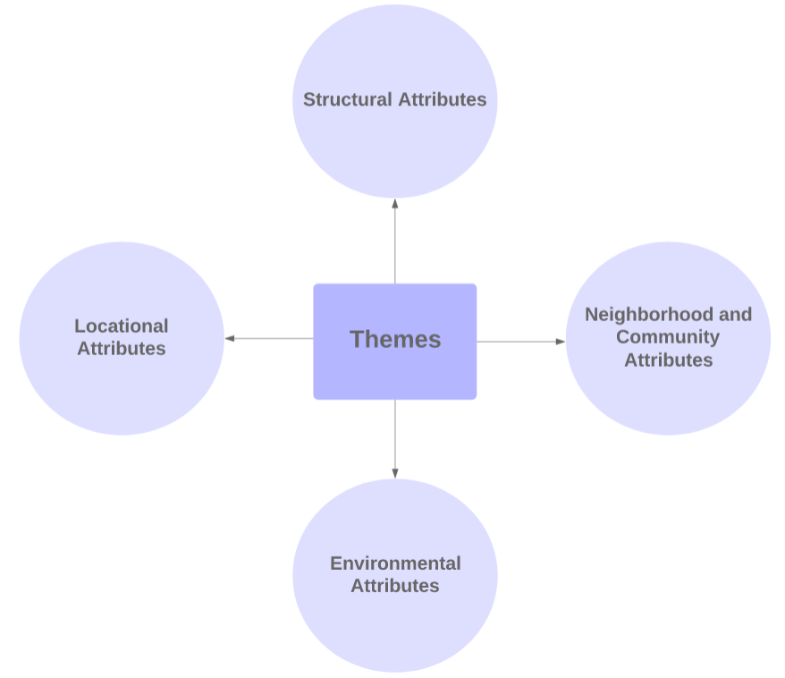
Literature Review
The DSPG team utilized a theme-driven conceptual framework to conduct research surrounding methods to address this question
Based on a literature review, what factors other than broadband predict property values?
Walkability
Crime Rates
Proximity to Amenities (transportation, parks, sports facilities)
Environmental Attributes (noise, flood risk, water quality)

Slide 100
Data Inventory
The DSPG team conducted an in-depth cross-reference comparison for the 3 major data sources, focusing on:
Data Collection Methods
Data Quality
Data Coverage
The outcomes of these activities will support development of heuristics and cross-referencing of resources surrounding Broadband data

Slide 101
Data Discovery: FCC Form 477
Fixed Broadband Deployment Data (as of December 2017)
Presence and Upload/Download speeds by Provider on block level
Provider-reported

Slide 102
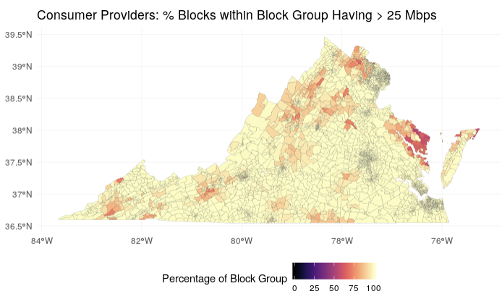
Data Discovery: FCC Form 477
Next Step:
add in Decennial Census data on population counts to determine % of population with access

Slide 103
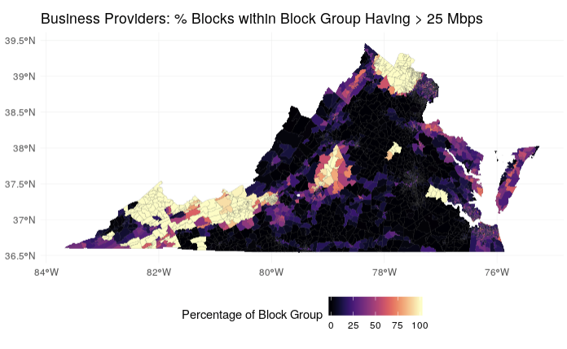
Data Discovery: FCC Form 477
Next Step:
add in Decennial Census data on population counts to determine % of population with access

Slide 104
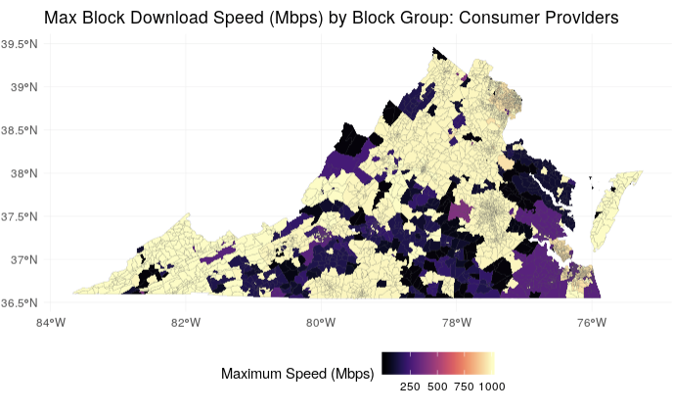
Data Discovery: FCC Form 477
Next Step:
may have to aggregate to ZCTA level for comparison to broadbandnow.com

Slide 105
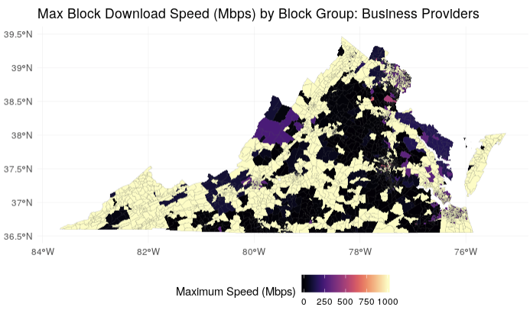
Data Discovery: FCC Form 477

Slide 106
Data Discovery: American Community Survey
2013-2017 Five-Year Summary
Presence and Types of Internet Subscription in Households
Presence of a Computer and Type of Internet Subscription by Household
Self-reported
Households

Slide 107
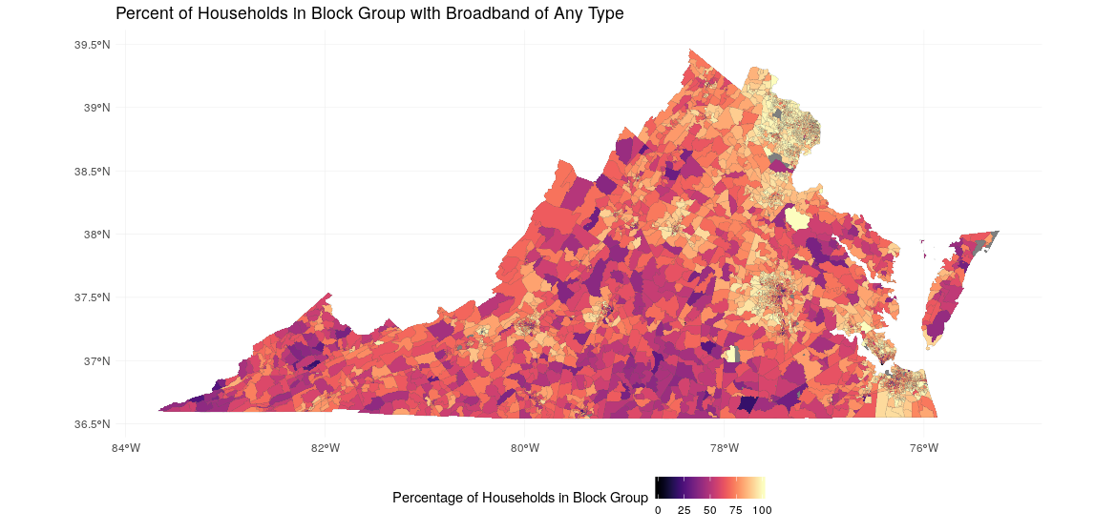
Data Discovery: American Community Survey

Slide 108
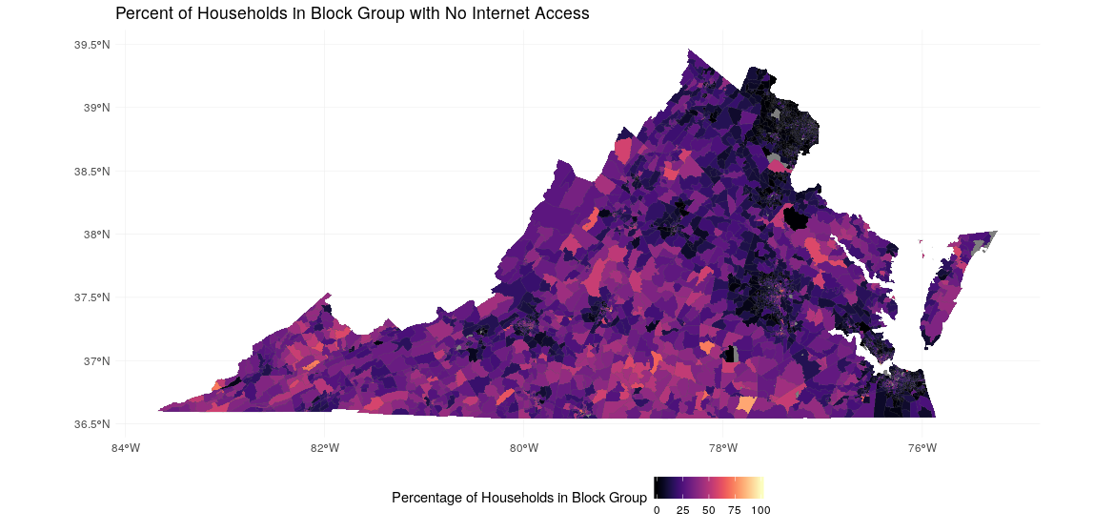
Data Discovery: American Community Survey

Slide 109
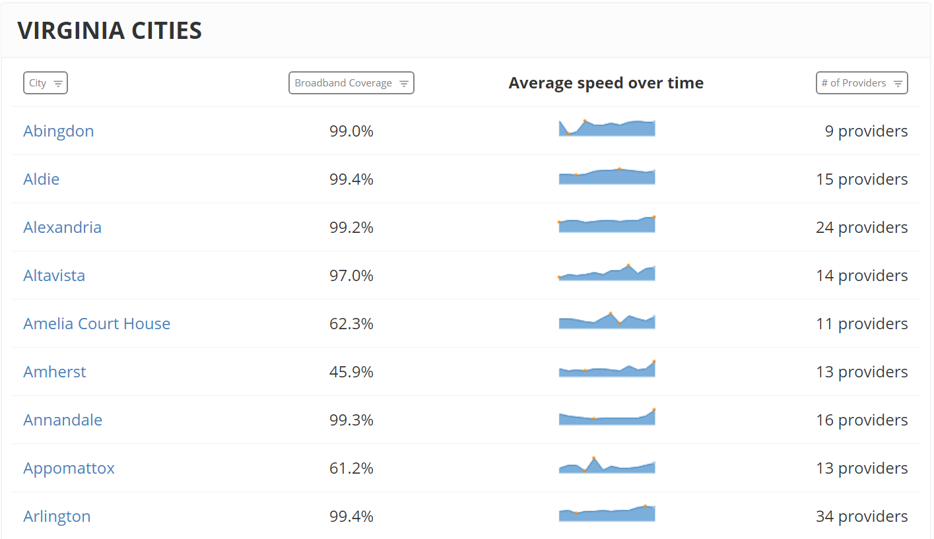
BroadbandNow.com
Broadbandnow is an online search engine which allows us to explore broadband availability data on a zip code as well as city/town level. We extract information regarding the number of providers, maximum and average upload and download speeds as well as the change in broadband speeds over time.

Slide 110
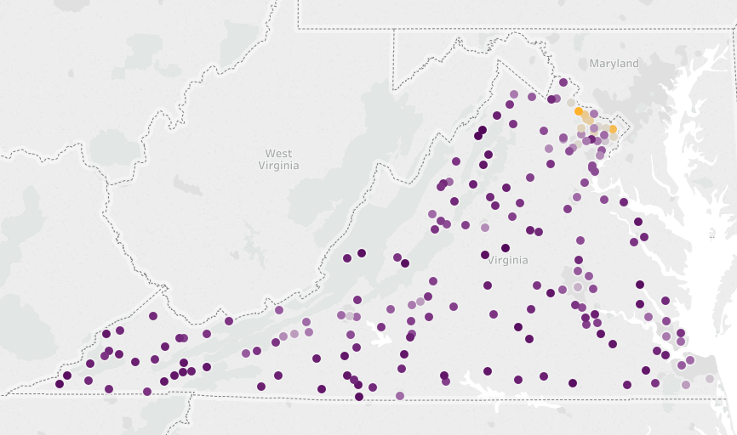
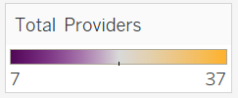
BroadbandNow.com
Total number of Broadband providers per city in VA

Slide 111
Ethics
Assumptions:
Broadband increases public wellbeing
Property value as a proxy for public wellbeing
Biases:
Data used has known misrepresentation issues
However, the goal of the study is to benchmark and validate the differing sources

Slide 112
Data Discovery: Next Steps
Finalize EDA exercise by reconciling and comparing the data across 3 major data sources
Incorporate rural-urban filter layers
Build quality metrics/heuristics to discuss data reliability

Slide 113
Economic and Social Impact:
Arlington Restaurant Initiative
Sponsors
Cpt. Michael Rowling
Arlington County Police Department Operational Support
MPO Dimitrios (Jim) Mastoras Arlington County Police Department Operations Support
Unit Restaurant Liaison Officer
Team
Lead: José Bayoán Santiago Calderón
DSPG: Kat Savchyn, Victoria Halewicz
SDAD: Gizem Korkmaz and Aaron Schroeder

Slide 114

Program Evaluation Project
Program Description:
Name: The Arlington Restaurant Initiative (ARI)
Goal: To foster a safe environment for customers, businesses and neighborhood residents in areas with nightlife and entertainment.
Implementation: The implementation includes components in training, an accreditation program, and community outreach.

Slide 115
Program Evaluation Project
Strategy:
Statistical modeling to attribute potential changes in alcohol-related crimes.
Estimate social (and government) cost attributed to alcohol-related crimes
Cost-benefit analysis of the cost of the program and estimated benefit.

Slide 116
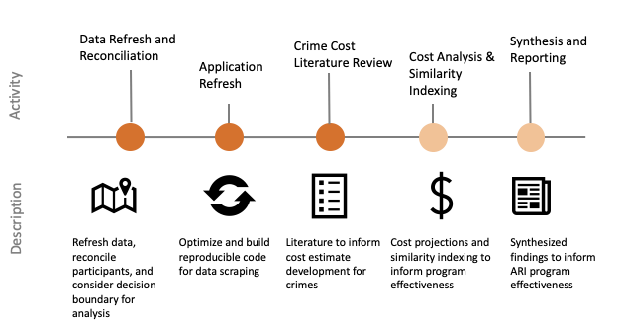
Timeline and Status

Slide 117
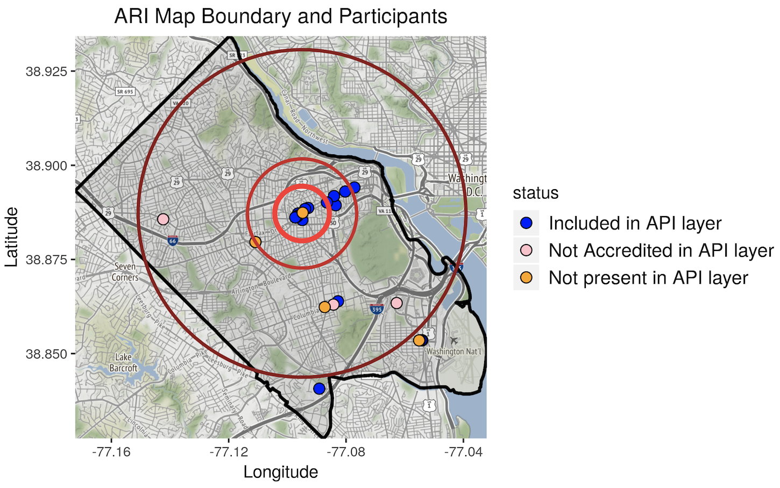
Data Refresh and Reconciliation
Sources:
ACPD Participating Restaurants List
Arlington Restaurant Initiative Participants Layer
MapQuest API

Slide 118

Application Refresh
Sources:
Arlington County Police Incident Log
ABC Virginia Hearing and Appeals: Final Decisions
ABC Virginia Licensee Data
Arlington Restaurant Initiative Participants API Layer

Slide 119

Application Refresh
Map View
Displays details on crime data, including location, description, event occurrence timestamp
Allows user to interactively search details by Crime Type

Slide 120

Application Refresh
Data View
Displays details on crime data, including location, description, event occurrence timestamp
Allows user to interactively search details by Crime Type

Slide 121

Application Refresh
Heatmap View
Displays day-by-day details on crime count by Year
Allows user to interactively view crime rates by Crime Type

Slide 122

Crime Indices
Aggravated Assault
Disorderly Conduct
Drunkenness
DUI
Sexual Assault/Rape

Slide 123
Crime Costs - Theory
Accounting
Dollar value on individual/society costs
Legal fees
Medical expenses
Contingent
Individual willingness to pay for a crime reduction using a survey
Provides an idea of perceived utility/value
(Heaton, 2010)

Slide 124

Literature Evaluation
Accounting Based
Contingent Valuation
Property loss: National Crime Victimization Survey (NCVS)
Uniform Crime Report (UCR)
National Incident-Based Reporting System (NIBRS)
Medical costs: Combined data from victim reports
Arlington Police Data

Slide 125
Cost Range
RAPE
$283,626
$150,000
AGGRAVATED ASSAULT
$122,943
$55,000
DISORDERLY CONDUCT
???
???
$
LOW
$$$
HIGH

Slide 126

Final Steps: Similarity Matrix
Restaurant A
Restaurant B
How?
Yelp web scraping:
-Dining vs. Drinking
-Age Demographics
ETC.

Slide 127
Returning Citizens Reentry Program
DSPG Team: Jessica Keast, Allegra Pocinki, Nathaniel Ratcliff, Joel Thurston, Gizem Korkmaz, Aaron Schroeder, and Bayoán Santiago Calderón
Sponsor: Dr. Gregory Fairchild, UVA Darden School of Business
June 28, 2019

Slide 128
Project Summary and Research Question
About Resilience Education:
Resilience Education sends MBA volunteer instructors into prisons to teach university-quality coursework focused on Entrepreneurship, Financial Capability, and Business Foundations. These courses give our students the opportunity to acquire the skills, confidence, and practical knowledge they need to chart a future outside prison walls.¹
What are the summative impacts of education during incarceration?
In addition to potential lowered recidivism, what are other benefits?
How does the existing collaborative program between Resilience Education and the Virginia Department of Corrections deliver these potential benefits?
¹ Resilience Education Executive Summary: https://static1.squarespace.com/static/5bc4fff016b6405451831f02/t/5ccc4ad97b81f800016ae8ef/1556892387541/R1+_+UPDATED+2+_+RE+Executive+Summary+%28February+2018%2C+Board%29+%282%29.pdf

Slide 129

Incarceration and Recidivism in the U.S. and Virginia
¹Bronson, J., Ph.D., & Carson, E. A., Ph.D. (2019, April). (Rep. No. NCJ 252156). Retrieved June 20, 2019, from Bureau of Justice Statistics website: https://www.bjs.gov/content/pub/pdf/p17.pdf
²Durose, M. R., Cooper, A. D., Ph.D., & Snyder, H. N., Ph.D. (2014, April). (Rep. No. NCJ 244205). Retrieved June 20, 2019, from Bureau of Justice Statistics website: https://www.bjs.gov/content/pub/pdf/rprts05p0510.pdf
³Recidivism at a Glance: Releases from State Responsible Incarceration(Rep.). (2019, May). Retrieved June 20, 2019, from Virginia Department of Corrections website: https://vadoc.virginia.gov/media/1412/vadoc-state-recidivism-report-may-2019.pdf
Notes:
national: incarceration https://www.bjs.gov/content/pub/pdf/p17.pdf
rearrest https://www.bjs.gov/content/pub/pdf/rprts05p0510.pdf; https://vadoc.virginia.gov/about/facts/research/recidivism/recidivism-at-a-glance-may2019.pdf
inmates released https://www.bjs.gov/content/pub/pdf/p17.pdf

Slide 130

Source: https://www.pep.org/wp-content/uploads/2018/07/ICIC_PEP-Impact-Analysis_final_post.pdf

Slide 131
Entrepreneurial Reentry Program¹
Two locations: Dillwyn (men’s) and Fluvanna (women’s) correctional facilities, Virginia
Four Entrepreneurial Educational Programs:
Entrepreneurship
Foundations in Business
Financial Capability
Achieving Success in Personal Finance
Objectives:
Deliver high-quality educational programming for underserved populations
Promote financial stability
Reduce recidivism
Expand perspectives of MBA volunteers
¹ Resilience Education Executive Summary: https://static1.squarespace.com/static/5bc4fff016b6405451831f02/t/5ccc4ad97b81f800016ae8ef/1556892387541/R1+_+UPDATED+2+_+RE+Executive+Summary+%28February+2018%2C+Board%29+%282%29.pdf

Slide 132


Participant Characteristics
Have a high school diploma or GED prior to entering the program
Be at least two years without an infraction or charge while incarcerated
Complete a math test
Priority is given to individuals who have 36 months or less until their release into the community
Sex offenders are generally excluded
As of May 2018, 298 individuals (159 female, 139 male) have completed at least one of the four courses; only 3 have completed all of the courses
Source: Virginia Department of Corrections, Resilience Education Programming: Preliminary Evaluation Summary. January 2019.

Slide 133
Literature Review
Prison re-entry has an adverse effect on returning prisoners and their communities, as well as significant financial costs
Benefits of prison educational programs:
Educational programs at all levels lower recidivism in most studies
Educational programs had positive effect on post-release earnings and employment*
College-level classes effective at lowering odds of inmates engaging in misconduct (other levels not studied)
Recidivism is an imperfect measure
Only accounts for reported crime
Not measured consistently
Considers returning offenders equally (even when inappropriate)
*when participants are compared against like groups

Slide 134

Information requests
From Resilience Education, we have received:
Video of Socratic Method in action
Course syllabi and descriptions
Math pre-test and final exam
Math practice tests
Sample business plan
Interview protocol
Sample case, sample teaching notes
From Virginia Department of Corrections we are hoping to receive:
number of infractions before and after course completion
release plans

Slide 135

Next Steps
Set up meeting with Virginia Department of Corrections
Get added to Darden IRB for this program
Get in touch with the Prison Entrepreneurship Program and ask for copy of their graduate survey as a guideline for creating our own survey for future administration by Resilience Education
Determine what kind of data collection and analysis is possible

Slide 136

Appendix
Source: Virginia Department of Corrections, Resilience Education Programming: Preliminary Evaluation Summary. January 2019.

